Slide 1
Prevention of Perioperative Pressure Ulcers Tool Kit
The Basics of Positioning Patients
in Surgery

Slide 2
Funded in part by grants from Sage Products, LLC and Medtronic through the AORN Foundation.

Slide 3
Objectives
Describe the most commonly used surgical positions.
State techniques for preventing injury to surgical patients.
Notes:
The objectives for today’s session are to
describe the most commonly used surgical positions, and
state techniques for preventing injury to surgical patients.

Slide 4
Goals of Positioning
Providing adequate exposure
Maintaining patient dignity
Allowing for optimum ventilation
Providing adequate access
Avoiding poor perfusion
Protecting fingers, toes, genitals
Protecting muscles, nerves, bony prominences
Notes:
The goals of patient positioning include
providing adequate exposure of the surgical site,
maintaining patient dignity by avoiding undue exposure,
allowing for optimum ventilation by maintaining a patent airway and avoiding constriction or pressure on the chest,
providing adequate access to IV lines and monitoring equipment,
avoiding poor perfusion due to elevation of extremities (eg, lithotomy),
observing and protecting fingers and toes and genitals, and
maintaining circulation and protecting muscles, nerves and bony prominences from pressure injury.
The anesthesia professional also needs to assess urinary output, blood loss and irrigation use. Therefore, visibility of measuring devices and drainage bags should be incorporated into the positioning plan.

Slide 5
Positioning Injuries
General/Regional anesthesia
  Physiologic changes
  Reduced movement/sensation
Notes:
Patients undergoing general or regional anesthesia are more at risk for skin injury due to the physiologic changes associated with anesthesia and the inability to move or feel pressure or pain.

Slide 6
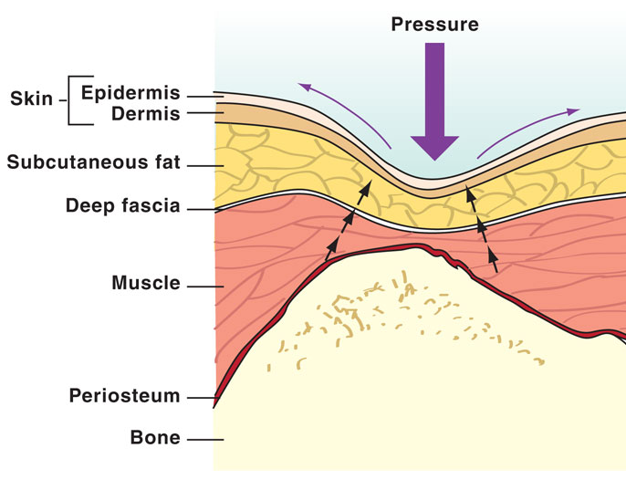
Positioning Injuries
Notes:
The physical forces of pressure, shear and friction often used to establish and maintain a surgical position and these forces can damage skin and underlying tissue.
Pressure is the force placed on underlying tissue.
Pressure can occur from the weight of the body as gravity presses it downward toward the surface of the bed.
Pressure also results from the weight of equipment or personnel resting on or against the patient.

Slide 7
Positioning Injuries
Pressure
Force placed on underlying tissue
Shear
Folding of underlying tissue
Friction
Force of two surfaces rubbing against one another
Notes:
Shear is the folding of the underlying tissue when the skeletal structure moves while the skin remains stationary such as might occur when the head of the bed is raised or lowered and when the patient is placed in Trendelenburg position.
Friction is the force of two surfaces rubbing against one another.
Friction on the patient’s skin can occur when the body is dragged across the bed linens instead of being lifted.
Friction can denude the epidermis and make the skin more susceptible to pain, infection and pressure ulcer formation.

Slide 8
Positioning Injuries
Moisture
Heat
Cold
Negativity
Notes:
Conditions such as moisture, heat, cold, and negativity further increase the vulnerability of the skin and underlying tissues to injury.

Slide 9
Positioning Injuries
Moisture
Produces maceration
Notes:
Moisture, in excess, can produce maceration that worsens the effects of pressure, shear, and friction.
Maceration occurs when prolonged moisture on the skin saturates the epidermis to the point that connective tissue fibers dissolve and can be easily torn apart.
Maceration can occur when the patient perspires excessively, or remains in a pool of prep or irrigation solution, blood, urine, or feces.

Slide 10
Positioning Injuries
Heat
Increases metabolism
Notes:
Heat on the body surface increases tissue metabolism and multiplies the demand for oxygen.
If the tissue is also under pressure, constriction of vessels may impede blood flow so that those metabolic demands are not met.

Slide 11
Positioning Injuries
Cold
Reduces O₂ delivery
Notes:
Cold environmental conditions, such as those found in the OR, can lead to hypothermia.
A cold core temperature can lessen peripheral circulation, reducing oxygen delivery to the skin and underlying tissue.

Slide 12
Positioning Injuries
Negativity
Increases pressure
Notes:
Negativity occurs when layers of materials, such as extra sheets or blankets are placed over the OR mattress or padding.
Extra linen is abrasive and diminishes the pressure-reducing properties of the mattress or padding. Therefore, extra layers of material between the patient and the OR bed mattress should be avoided as much as possible.
Remember to take the extra seconds required to untie the patient’s gown and ensure that the gown and blanket do not become lodged under the patient.

Slide 13
Positioning Injuries
Nerves
Stretching or compression
Most common sites
Brachial plexus
Peroneal
Facial
Transient or permanent damage
Notes:
Stretching or compression of the nerves is another positioning injury that can result in either transient or permanent nerve damage.
The most common sites of injury associated with positioning are the brachial plexus, peroneal, and facial nerves.

Slide 14
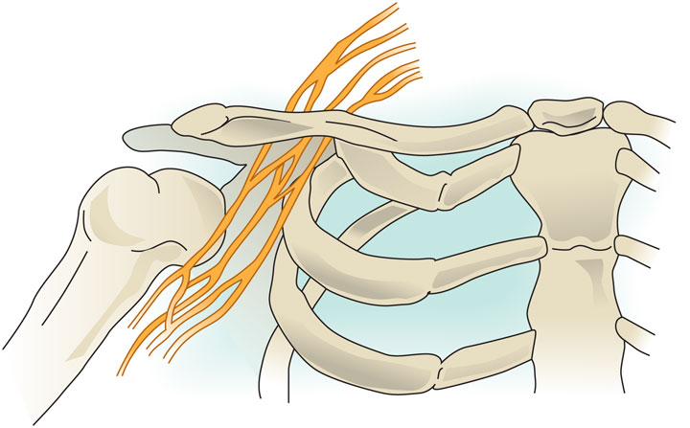
Positioning Injuries
Bracheal plexus
  Shoulder
  Arm
  Hand
Notes:
The brachial plexus consists of a bundle of nerve cords that innervate the shoulder, arm, and hand.

Slide 15
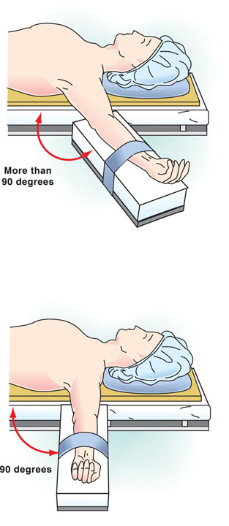
Positioning Injuries
Bracheal plexus injury
  Armboards extended beyond 90°
  Armboards higher or lower than OR bed
  Lateral rotation of patient’s head
  Leaning against shoulder or arm
  Shoulder braces
Notes:
Incorrect positioning techniques that increase the risk of brachial plexus injury include
placing the arms on armboards that extend beyond a 90° angle to the body;
using an armboard that is higher or lower than the OR bed;
extreme lateral rotation of the patient’s head;
leaning against the shoulder or arm while it is tucked against the body; and
shoulder braces used to support the patient in Trendelenburg’s.

Slide 16

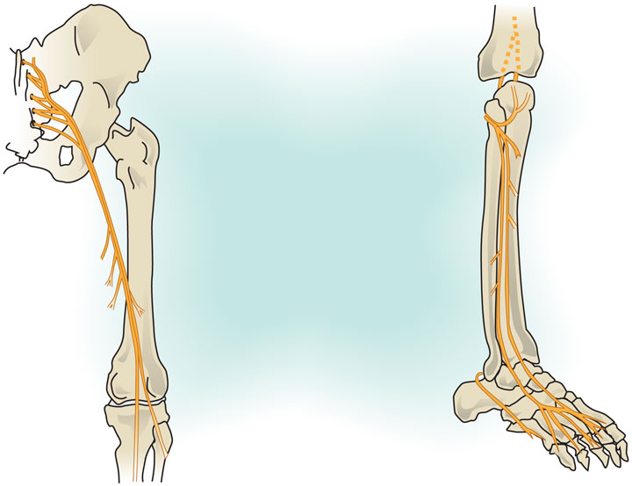
Positioning Injuries
Common peroneal
  Lower leg
  Foot
  Toes
Sciatic
Common Peroneal
Tibial
Notes:
The common peroneal nerve is a branch of the sciatic nerve that supplies movement and sensation to the lower leg, foot and toes.

Slide 17
Positioning Injuries
Common peroneal injury
  Direct compression
  Patients who are thin
  Hyperextension of knees
  Pressure behind knee
  Graduated compression stockings too tight
  Foot drop/Lower extremity paresthesia
Notes:
The common peroneal nerve is extremely vulnerable to direct compression injuries caused by rigid surfaces (eg, stirrup bars, bean bag).
The risk for injury to the common peroneal nerve is also increased in patients who are thin and have minimal overlying tissue in this area.
The muscle-relaxing effects of anesthesia can lead to hyperextension of the knees, and this hyperextension can stretch the peroneal and tibial nerves. This is one of the reasons that the knees should be supported during surgery.
However, excessive pressure behind the knee can compress the peroneal and tibial nerves where they pass through the popliteal fossa; therefore, only soft padding or pillows should be used for knee support.
Graduated compression stockings that are too tight can apply excessive pressure to the common peroneal nerve and tibial nerves.
Injury to the peroneal nerve can result in foot drop or lower-extremity paresthesia.

Slide 18
Positioning Injuries
Pulmonary
Hypoxia
Respiratory compromise
Decreased 0₂ saturation
Pulmonary edema
Congestion
Atelectasis
Notes:
Poor patient positioning can also adversely affect pulmonary function.
Interference with pulmonary function can lead to hypoxia and respiratory compromise, and when combined with circulatory compromise from excessive pressure, can decrease the overall oxygen saturation of the blood.
As well, the normal flow of secretions may be affected causing fluid to shift into the alveoli resulting in pulmonary edema, congestion and atelectasis.

Slide 19
Positioning Injuries
Corneal abrasion
Central retinal artery occlusion
Ocular
Blood loss
Length of procedure
Prone
Risk factors
Notes:
One of the most devastating positioning injuries is damage to the eye.
The eyes do not always close during anesthesia, so they are vulnerable to abrasion from the movement of the face against the sheets, pillows, or drapes in certain positions and from being brushed by IV lines, masks, fingers, or the clothes of personnel.
For this reason, when the patient is unconscious, the eyelids should be lubricated and taped shut.
Direct pressure on the eye, coupled with natural systemic hypotension from anesthesia, can cause central retinal artery occlusion which can result in temporary or permanent blindness.
Risk factors for eye injuries include
the use of the prone position,
the length of the procedure (ie, specifically, procedures lasting longer than six and a half hours), and
significant blood loss during the procedure.

Slide 20
Positioning Injuries
Obese or underweight
Poor nutritional status
Advanced age
Preexisting conditions
History of skin breakdown/pressure ulcers
Smoking
Notes:
Patient factors that increase the risk for positioning injuries during surgery include
obese or underweight;
poor nutritional status;
advanced age (ie, age 70 or older);
advanced age alone is not necessarily the only determining factor,
a healthy 82-year old may be less vulnerable than a 35-year old with diabetes,
preexisting conditions (eg, arthritis, diabetes, hypertension);
history of skin breakdown or pressure ulcers; and
smoking which may lead to vasoconstriction, thereby increasing the risk of pressure ulcers.

Slide 21
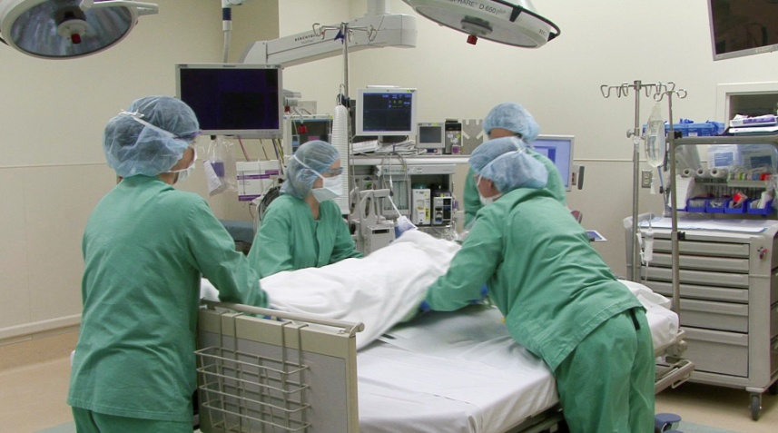
Positioning Process
Collaborative process
  Selection of equipment
  Preoperative assessment
  Positioning
  Documentation
  Postoperative evaluation
Notes:
Positioning is more than just the physical act of twisting and bending the patient into the desired position on the OR table.
Positioning the surgical patient is a collaborative process which involves the surgeon, anesthesia professional, perioperative RN and other perioperative team members (eg, first assistant, patient care technicians).
The process of positioning includes
the selection of the appropriate equipment for the procedure (eg, axillary rolls, stirrups),
a careful preoperative assessment,
positioning the patient,
thorough documentation of the positioning process, and
a postoperative evaluation of the success of the applied positioning techniques.

Slide 22
Selection of Equipment
Inspected and maintained
Checked prior to procedure
Competent surgical personnel
Notes:
Positioning equipment should be used to protect, support and maintain the patient's position with additional padding used to protect bony prominences.
Positioning devices and equipment should be inspected on a regular basis and maintained in good working condition.
Any equipment scheduled for use during the procedure should be checked before use to verify that the surface is smooth and intact.
Surgical personnel must be competent when using positioning devices and equipment. It's essential to know and comply with facility policies and procedures as well as to review manufacturers’ instructions that accompany positioning devices and equipment. Often these documents contain restrictions to the use of such devices and also outline weight limits for the patients who will use the equipment.
Both patients and health care workers are at risk for injury if equipment is not used according to the manufacturer's specifications.

Slide 23
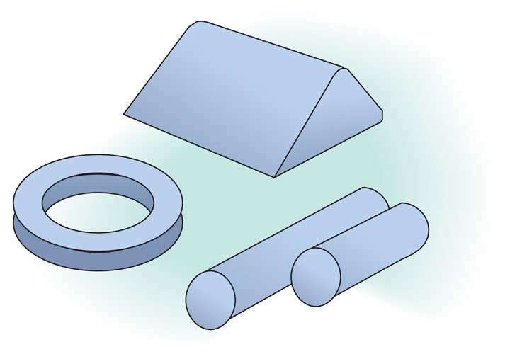
Selection of Equipment
Pressure relieving surface
  Disperses weight
  Prevents “bottoming out”
  Relieves shear and friction
Notes:
An effective pressure-relieving surface will
disperse the patient’s body weight over a large area, especially over bony prominences and other high-risk areas.
Rolled blankets and towels should not be used as positioning devices because they create pressure and do not redistribute the weight over a larger area.
prevent bottoming out (ie, when the patient’s body pushes down on the mattress so far that it touches the hard surface), and
reduce shear and friction when the patient moves on the surface by providing optimum support and stability.

Slide 24
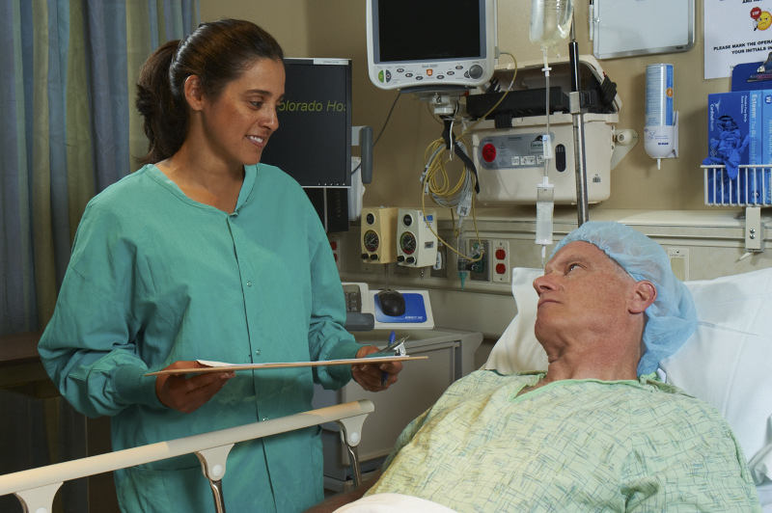
Preoperative Assessment
Age/Height/Weight/Body mass index (BMI)
Nutritional status
Blood pressure
Skin integrity
ROM/Physical limitations
Internal/External devices
Preexisting conditions
Medical history
Diagnostic studies
Psychological/Cultural considerations
Notes:
The preoperative assessment includes a patient interview, a physical examination, and a review of medical records. Items to be assessed include
age;
height;
weight;
body mass index (BMI);
nutritional status (check for decreased muscle mass, signs of dehydration);
blood pressure (hypertensive patients may react unexpectedly to a reduction in blood pressure that may result in a loss of blood flow through stenotic vessels);
skin integrity;
range of motion, or any physical limitations;
presence of any internal or implanted devices (eg, artificial joint, pacemaker);
presence of external devices (eg, catheter, colostomy bags);
presence of jewelry and/or piercings (if not removed, may contribute to pressure injuries);
preexisting conditions (eg, diabetes, peripheral vascular disease);
medical history (eg, history of previous pressure ulcer);
results of diagnostic studies and laboratory tests (low serum albumin); and
psychological and/or cultural considerations.
The identified patient factors should be considered in relation to the type and length of the scheduled procedure and the access required by the surgical team and the anesthesia professional.

Slide 25
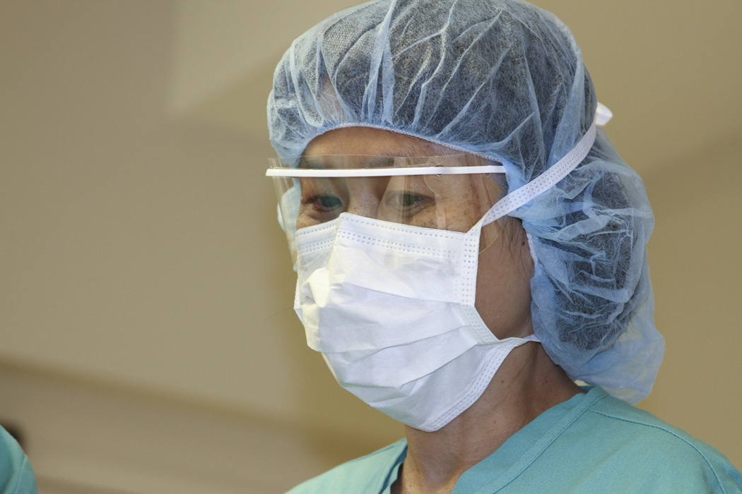
Selection of Position
Notes:
Although the choice of position for a particular procedure ultimately rests with the surgeon, the decision should be made in collaboration with the anesthesia professional, perioperative RN, and other appropriate members of the surgical team (eg, first assistant).
As an advocate for the patient, perioperative RNs should question the surgeon’s chosen position if they believe it may compromise the patient’s safety.

Slide 26
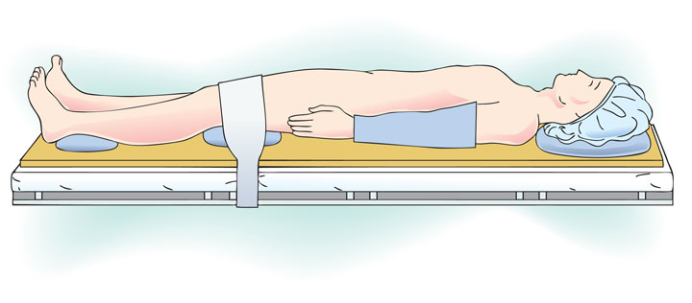
Supine
Notes:
The supine position is the most commonly used surgical position.
The most common injuries related to the supine position are pressure ulcers on the occiput, scapulae, thoracic vertebrae, elbows, sacrum, and heels. These areas should be adequately padded during the procedure.
In this position, the patient’s arms should either be secured at the sides, or extended on armboards.
The safety strap should be placed across the thighs, approximately two (2) inches above the knees with a sheet or blanket placed between the strap and the patient’s skin.
The patient's heels should be elevated off the underlying surface when possible.

Slide 27
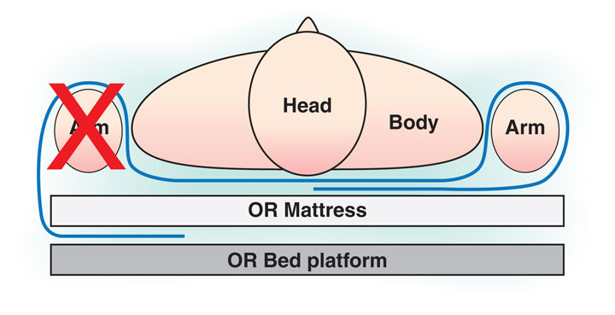
Supine
Notes:
When tucking the arms close to the body, palms should face the body.
The drawsheet should be tucked under the patient and not be tucked under the mattress, because the combined weight of the mattress and the patient’s torso may impair circulation or cause nerve torsion and increase the risk for compartment syndrome.

Slide 28
Supine
Notes:
If an armboard is used, the armboards should be padded with the pad level equal to that of the OR bed.
The arms should be extended at no more than a 90° angle at the shoulder to prevent brachial plexus injury.
The patient’s hands should be placed palm up to prevent ulnar nerve pressure.
Wrist restraints should be used to secure the arms to the armboard; however, these restraints should be padded and should not be secured too tightly.

Slide 29
Trendelenburg
Notes:
During the mid-1800s, Frederich Trendelenburg, a renowned surgical pioneer, began inclining his patients in the head down position, hence the name Trendelenburg position (feet higher than head).
Visibility and accessibility to abdominal and pelvic organs is increased in this position; however, the decrease in respiratory exchange due to the displaced viscera pressing against the diaphragm and pooling of blood in the upper torso poses a serious danger to the patient.
Intracranial pressure is also increased.
Patients should be placed in the Trendelenburg position for the shortest amount of time possible.
The patient should be taken out of Trendelenburg’s position slowly to allow the body to readjust to the change in blood volume.

Slide 30
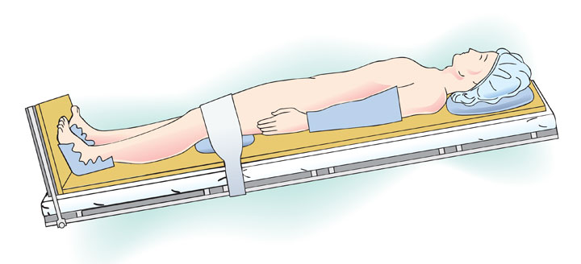
Reverse Trendelenburg
Notes:
In the reverse Trendelenburg position, the feet are lower than the head.
A well-padded footboard should be used to help maintain alignment and prevent peroneal nerve damage.
Lumbar and small pillows placed under the knees may help to prevent the body from slipping while lessening strain on the patient’s back and legs.

Slide 31
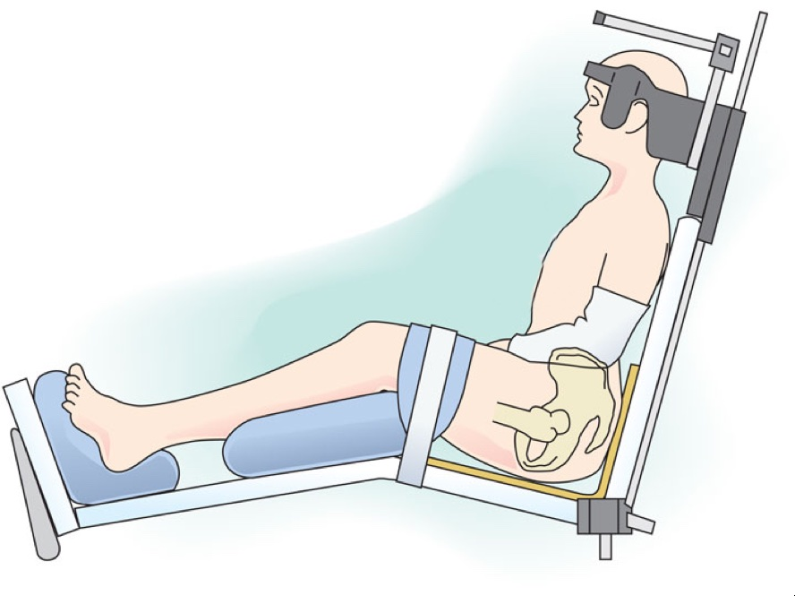
Sitting/Modified-Sitting
Notes:
The sitting or modified-sitting position, also known as Fowler or Semi-Fowler, or Beach chair, has been used for surgery since the 1800s when it was used routinely for head and neck procedures and for dental operations.
This position offered minimal restriction to ventilation at a time when all patients breathed spontaneously during surgery.
The point of maximum pressure in this position is the ischial tuberosities.
Prolonged pressure on the ischial tuberosities can lead to sciatic nerve damage.
Therefore, pressure points (especially the ischial tuberosities, coccyx, and calcanei), should be adequately padded to reduce the risk of injury.
This position poses significant risks for circulatory compromise. Blood pools in the lower torso and legs leading to significant orthostatic hypotension and diminished perfusion to the brain. Venous return from the lower extremities is also impeded, increasing the risk for venous thromboembolism.

Slide 32
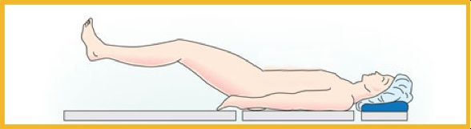
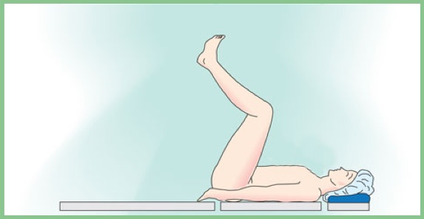
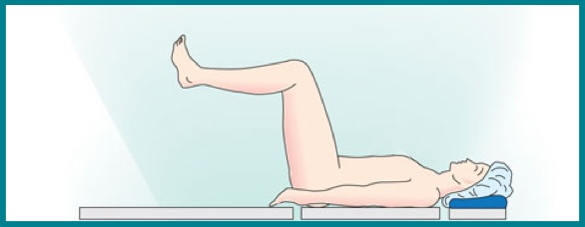
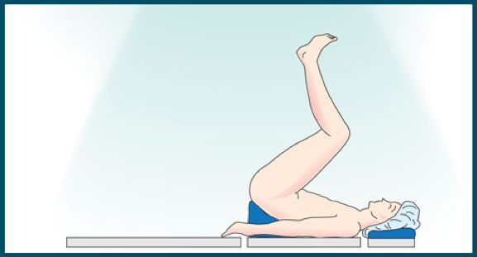
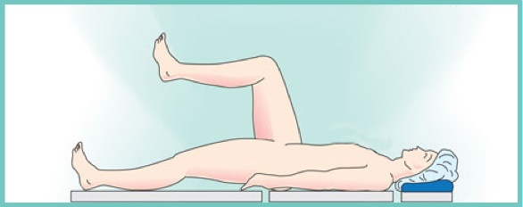
Lithotomy
Low
High
Standard
Exaggerated
Hemi
Notes:
In the lithotomy position, the patient’s legs may be placed in one of five lithotomy positions depending on how high the legs and pelvis must be elevated for the procedure:
low,
standard,
hemi- (when only one leg is in the lithotomy position),
high, and
exaggerated
The patient’s legs should be placed in the lowest position possible for the procedure.
The legs should be checked periodically for distal pulses and skin color.

Slide 33
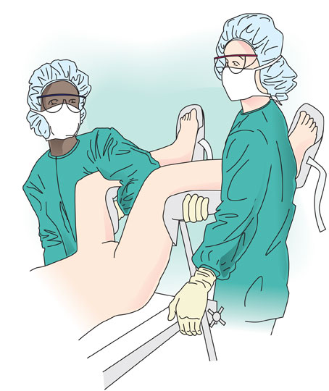
Lithotomy
Notes:
The lithotomy position requires the use of some type of leg holder.
Stirrups should be securely fastened to the OR bed rail and checked before placing the patient’s legs into the stirrups.
Slippage of the stirrups or dropping of the legs during stirrup adjustments could cause hip dislocation, muscle or nerve injury, or bone fractures.
To avoid back strain and hip dislocation, stirrups or leg holders should be placed at an even height and the legs should be placed in and removed from the leg holders at the same time.

Slide 34
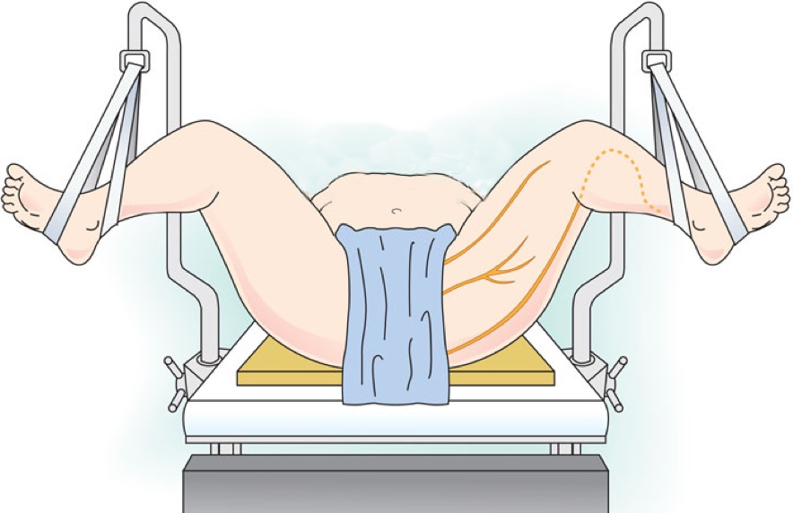
Lithotomy
Common peroneal
Femoral
Obturator
Notes:
Candy cane stirrups are problematic for pressure injuries and neuropathies to the ankle due to the relatively thin ankle straps that must support the weight of the entire leg.
Using wide straps, or cradling the feet with gel or foam padding may help to reduce the localized pressure.
Surgical team members should take care to verify that the patient’s legs do not rest against the stirrup posts in order to prevent peroneal nerve damage.
Candy cane stirrups do not control or limit hip abduction.
The relaxed hips of an anesthetized patient may separate further than they comfortably would if the patient were awake.
Exaggerated rotation and flexion can stretch the sciatic and obturator nerves and strain the hip joints and muscles.
Boot-type stirrups support the foot and calf, distribute pressure more evenly, and reduce the risk of extremely localized pressure on any one area of the foot or leg.
They also allow for more controlled and limited hip abduction and flexion.

Slide 35
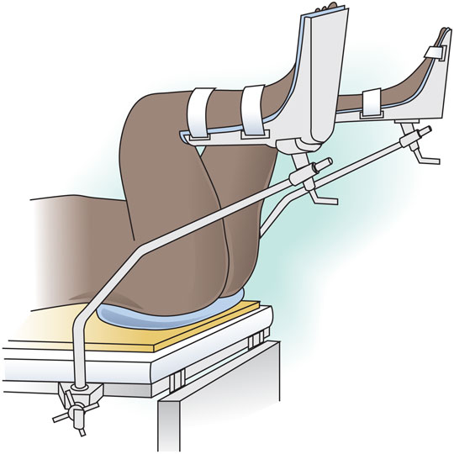
Lithotomy
Notes:
The patient should be positioned so that his or her buttocks are even with the lower break of the procedure bed.
Additional padding may be required to prevent skin breakdown on the sacrum.
As in the supine position, arms may be tucked at the sides or placed on armboards.
When tucked at the sides, great care should be exercised to prevent injury by ensuring that hands and finger are clear when the foot of the bed is raised or lowered.
Patients in the lithotomy position for prolonged periods of time are also at risk for compartment syndrome, an uncommon but potentially severe complication of surgical positioning that is caused by compression of the arteries and reduced blood supply to the limbs.
The patient should be in the lithotomy position for the shortest amount of time possible.
For procedures lasting longer than four hours, it may be prudent to reposition the patient if possible.

Slide 36
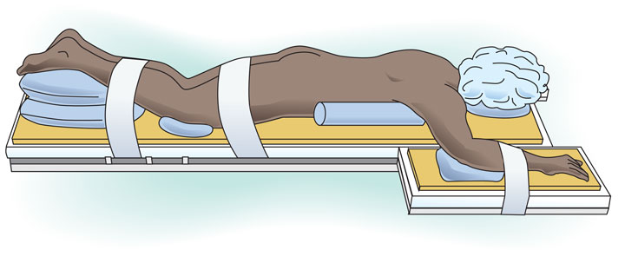
Prone
Notes:
Injuries in the prone position include
corneal abrasion and ocular damage;
respiratory compromise due to compression of the abdomen; and
pressure ulcers on the abdomen, breasts, genitalia, knees, and toes.
Placing a headrest under the patient’s head provides for airway access and helps prevent injury to the eyes.
Eyes should be protected and assessed regularly.
Forehead and chin should also be protected.
Cervical neck alignment should be maintained and the head should be positioned in neutral forward position without significant neck flexion, extension, or rotation.
Placing two large chest rolls from the clavicle to the iliac crest raises the weight of the body from the abdomen and thorax and allows the diaphragm to move freely and the lungs to expand.
Female breasts should be moved laterally to reduce pressure on them; however, soft ventral supports on the lateral sides of the breasts, diverting the breasts toward the midline, are generally better tolerated.
Male genitalia should be free from pressure.
Pendulous skin folds should not be crimped under the patient in any manner.

Slide 37
Prone
Notes:
The patient’s toes should be positioned so that they are elevated off the bed by padding under the patient’s shins.
Padding should also be provided to protect the knees.
In the prone position, the patient’s arms should be placed at his or her sides or on armboards at less than a 90° angle at the shoulder with elbows flexed and palms facing downward.
Hands and wrists should be kept in normal alignment.
Placing the patient’s arms above his/her head should be avoided to minimize the risk of stretch injury to the brachial plexus.
A stretcher or transport cart should be immediately available for emergency repositioning into the supine position for cardiopulmonary resuscitation should the need arise.

Slide 38
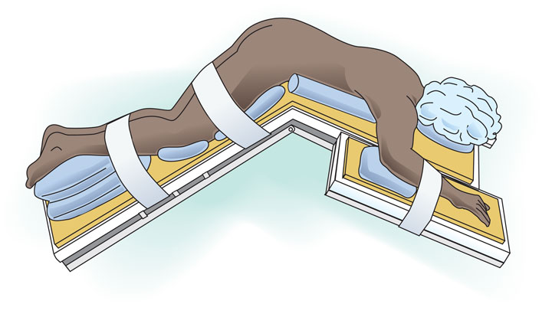
Jackknife
Notes:
The jackknife, or Kraske, position is a variation of the prone position and thus requires the same precautions.
It has been said that this is the most dangerous of all surgical positions.
This position causes circulatory changes because the head and the feet are in dependent positions,. causing cephalad and caudad venous pooling.

Slide 39
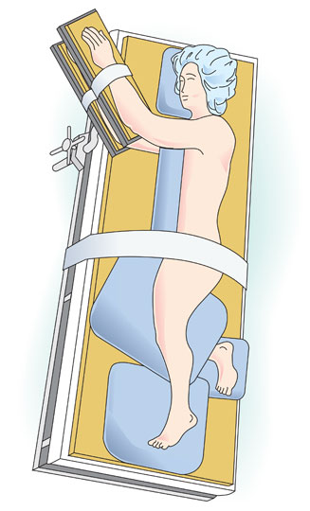
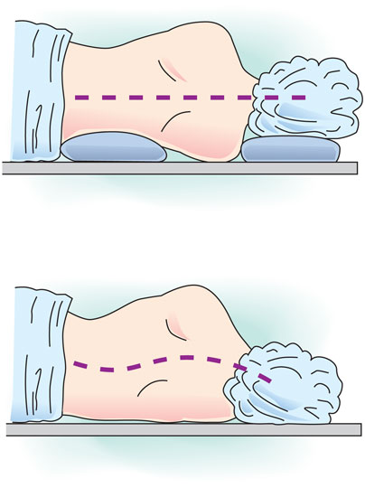
Lateral
Right = Left
Notes:
In the lateral position, the patient is positioned on the nonoperative side.
When documenting a right lateral position, the patient is lying on his/her right side.
This position provides exposure for a left sided procedure.
A headrest or pillow should be placed under the patient’s head to maintain alignment of the patient’s spine.
The patient’s dependent ear should also be monitored to verify that it is well padded and not folded.
An axillary roll should be placed under the rib cage, posterior to the axilla.
This places the weight of the chest on the rib cage instead of compressing the lower shoulder and axilla, which otherwise may injure the brachial plexus of the dependent arm.
Radial pulses must be monitored to confirm adequate circulation in the dependent hand and arm.
There have been reports of pressure ulcers occurring on the dependant thorax after use of wrapped IV fluid bags being used as axillary rolls.
The patient’s upper arm should be secured on a padded armboard in front of the patient, and the lower arm should be flexed and placed on a separate padded armboard.
In the lateral position, the patient’s lower leg should be kept flexed, and the upper leg should be kept straight.
A pillow should be placed between the legs to prevent undue pressure.
Padding should be used under the knee, ankle and foot of the dependent leg.

Slide 40
Lateral
Notes:
This position increases the risk for pressure ulcers on vulnerable areas on the patient’s dependent side (eg, acromion process, ear, greater trochanter, iliac crest, lateral knee, malleolus).
There is an increased risk for ulceration when a solid object or positioning device (eg, bean bag) is used to maintain patients in this position.
The firm pressure of the device may compromise the circulatory system due to the tight restraint and because of the overall effect of gravity on the horizontal body posture.
In addition, patients may experience damage to the common peroneal nerve if the dependent leg becomes compressed between the fibula and the procedure bed.
Vulnerable areas should be adequately padded during the procedure.

Slide 41
Obese Patients
Obese
BMI greater than 40 kg/m²
More than 100 lbs overweight
Notes:
Persons who are classified as obese have a BMI that is greater than 40 (normal adult BMI is 18 to 25), or weigh 100 pounds or more over their recommended weight.

Slide 42
Obese Patients
Health conditions
Type II diabetes
Hypertension
Atherosclerosis
Sleep apnea
Alveolar hypoventilation
Urinary stress incontinence
Gastroesophageal reflux (GERD)
Arthritis
Notes:
Patients who are obese tend to have other health conditions such as
Type II diabetes
Hypertension
Atherosclerosis
Arthritis of weight-bearing joints
Sleep apnea
Alveolar hypoventilation
Urinary stress incontinence
Gastroesophageal reflux disease (GERD)
Obese patients are at a significantly greater risk for adverse outcomes than other patients and special care should be taken to minimize these risks.

Slide 43
Obese Patients
Respiratory issues
Airway compromise
Difficult intubation
Aspiration
Hypoxia
Intra-abdominal pressure
Notes:
Obese patients are prone to certain respiratory issues including:
Airway compromise
Difficult intubation
Aspiration
Hypoxia
Intra-abdominal pressure on the diaphragm

Slide 44
Obese Patients
Circulatory issues
Increased cardiac output
Increased pressure on pulmonary artery
Risk of inferior vena cava compression
Notes:
As well as the following circulatory issues:
Increased cardiac output
Increased pressure on the pulmonary artery
Risk of compression of the inferior vena cava

Slide 45
Obese Patients
Skin issues
Difficult assessments
Moisture
Skin breakdown
Notes:
Assessments of skin condition on obese patients may be difficult because of the patient’s large size.
There may also be areas of skin breakdown and moisture beneath skin folds.

Slide 46
Obese Patients
Special equipment
Procedure beds
Side attachments/Stirrups
Pressure relieving surfaces
Extra-wide/long safety straps
Notes:
Positioning obese patients may require the use of specialized equipment. The procedure bed should be capable of articulating and supporting the weight of the patient and there may be a need for extra-wide and/or extra-long safety straps.
Surgical team members should determine, based on the width of the patient’s legs, if a side attachment to the procedure bed, or stirrups are necessary.
Surfaces should provide sufficient support and padding, and a pressure relieving surface that is capable of supporting the patient’s weight without bottoming out should be used.

Slide 47
Obese Patients
Position
Sitting/Modified-sitting
Lateral
Supine with wedge under right side
Notes:
For many procedures, obese patients may need to be positioned in a sitting, modified-sitting, or lateral position to prevent respiratory or circulatory compromise.
If the supine position is used, it may be necessary to place a roll or wedge under the patient’s right side to reduce compression of the vena cava.
These measures should also be taken for women in the third trimester of pregnancy.

Slide 48
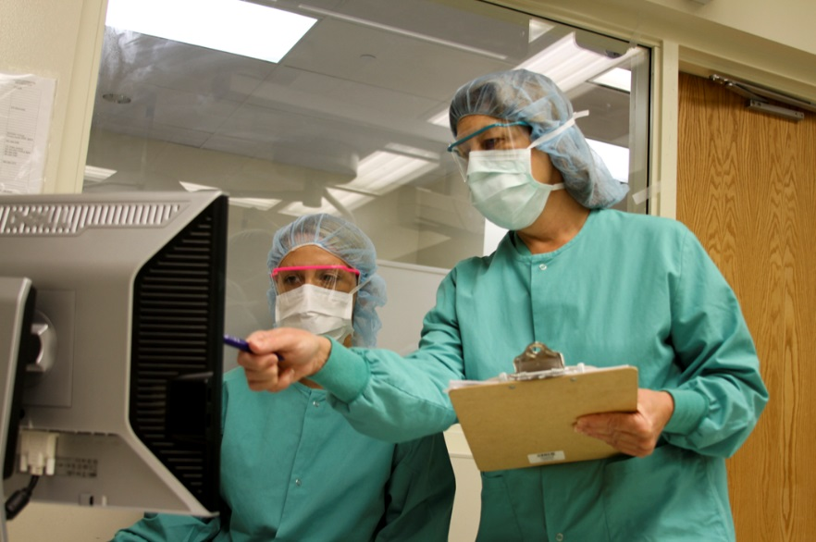
Documentation
Preoperative assessment
Names/titles participants
Patient position
Upper extremities
Lower extremities
Equipment/Padding
Specific actions
Repositioning
Postoperative assessment
Notes:
The perioperative RN should be diligent to document any actions taken related to patient positioning.
At a minimum, the following information should be documented:
Preoperative assessment
Names and titles of persons participating in the positioning of the patient
Patient position throughout the operative process
Position of the patient's arms (eg, extended on armboards at <90° with palms up)
Position of the patient's lower extremities
Type and location of positioning equipment
Padding (ie, use of, type of, location of)
Specific actions taken during the operative process to prevent patient injury (especially actions taken in response to the preoperative assessment)
Repositioning activities during the course of the procedure
Postoperative assessment

Slide 49
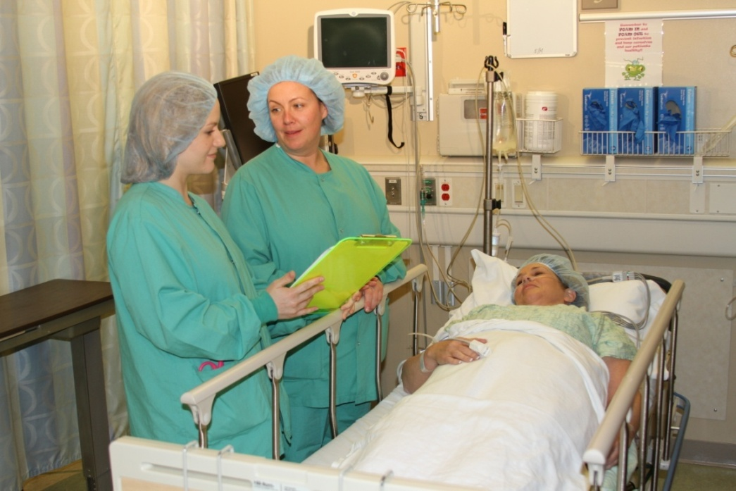
Postoperative Assessment
Nerve injury
Pressure injury
Reposition
Transfer of care
Notes:
At the conclusion of the surgical procedure, the perioperative RN should assess the patient for signs of intraoperative injury and should closely inspect for any areas identified during the preoperative assessment as high risk for injury.
Symptoms indicative of nerve injuries include
decreased range of motion;
impaired muscle strength;
numbness, tingling; and
pain in limbs or joints not associated with procedure.
Pressure injuries may not appear for one to four days after surgery. They have a unique purple appearance and originate at the muscle over bony prominences and progress outward. However, all pressure areas should be assessed for redness and inappropriate blanching of the skin.
In addition, the RN should reposition the patient during the postoperative period to avoid continuing to apply pressure to the same areas under pressure during the procedure.
Results of the postoperative assessment should be included in the transfer of care report to the perioperative post anesthesia care RN.

Slide 50
References
Guideline for positioning the patient. In: Guidelines for Perioperative Practice. Denver, CO: AORN; 2015.

Slide 51
Thank you
  Sharon A. Van Wicklin, MSN, RN, CNOR, CRNFA(E), CPSN-R, PLNC
  Senior Perioperative Practice Specialist
  Association of periOperative Registered Nurses (AORN)
  Denver, CO.
for preparing the content of this educational slide deck.

Slide 52
Prevention of Perioperative Pressure Ulcers Tool Kit
The End

