Slide 1
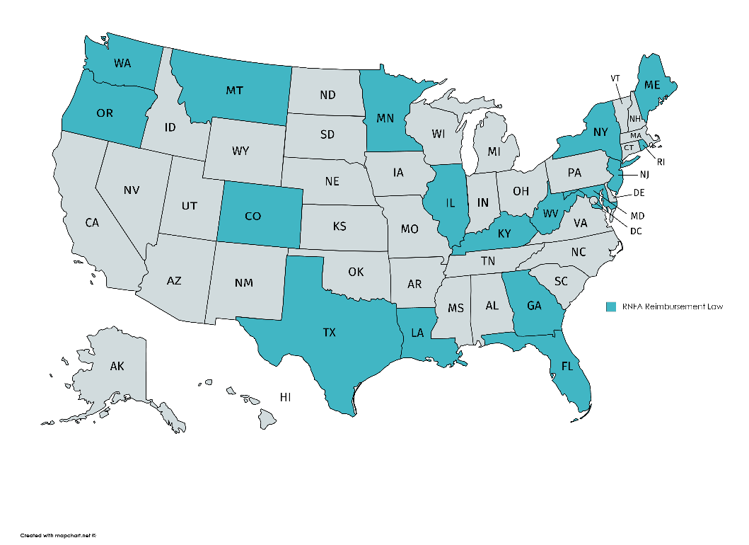
AORN RNFA Reimbursement Map
*States in teal have RNFA reimbursement laws

