Slide 1
Standardizing Hand offs for
Patient Safety

Slide 2
Objectives
Understand the background to National Patient Safety Goal 2E
Discuss 3 methods of achieving effective Hand-offs
State how strategies developed in high reliability organizations (HROs) can be applied to Hand-offs

Slide 3
Institute of Medicine Report
Impact of Error:
  44,000–98,000 annual deaths
  occur as a result of errors
  Medical errors lead followed
  by surgical mistakes and
  complications
  More Americans die from medical errors than from breast cancer, AIDS, or car accidents
  7% of hospital patients experience a serious medication error
Federal Action
By 5 years:
↓ medical errors by 50%,
nosocomial by 90%,
and eliminate “never-events” (e.g., wrong-site surgery)

Slide 4
Institute of Medicine Report
Cost associated with medical errors is $8–29 billion annually.

Slide 5
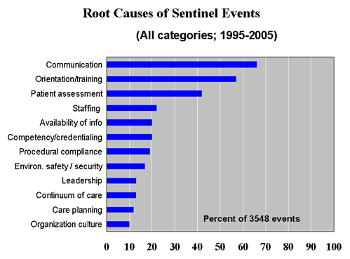
Communication Issues Leading
Factor in Root Causes
Targets for Teamwork
Collation of sentinel event-related data reported to The Joint Commission (1995-2005). Available http://www.jointcommission.org/SentinelEvents/Statistics/
Notes:
Of over 3548 events, most of the ROOT CAUSES can be addressed by improved teamwork:
Improved communication, leadership, adherence to protocols and policies, sharing information, and moving toward a culture of quality and safety.

Slide 6

Joint Commission
National Patient Safety Goal-2E
Implement a standardized approach to “hand-off” communications including an opportunity to ask and respond to questions.

Slide 7
Joint Commission
National Patient Safety Goal-2E
Implementation Expectations:
Interactive communications allowing
the opportunity to
ask or respond to questions
Include up to day information regarding:
  Care
  Treatment
  Services
  Condition
  Recent or anticipated changes

Slide 8
Implementation Expectations (cont.):
Limited interruptions
Sufficient time allocated
Process for verification of the information
  Repeat back
  Read back
Receiver reviews relevant historical patient data including:
  Previous care
  Previous treatment
  Previous services

Slide 9
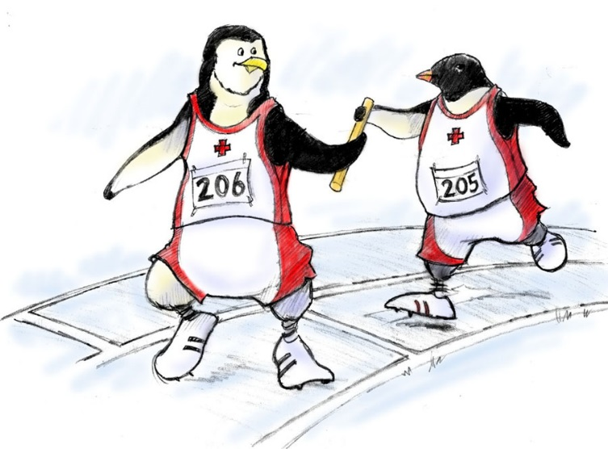
Hand off Defined
The transfer of information (along with authority and responsibility) during transitions in care across the continuum for the purpose of
ensuring the
continuity and safety
of the patient’s care.

Slide 10
Types of Hand offs
On call responsibilities
Critical reports (laboratory and imaging )
Hospital transfers (home, skilled nursing facility)
Other transitions in care (ED, radiology, physical therapy)

Slide 11
Types of Hand offs (cont.)
Patient hand-offs
  Level of care (cross coverage)
Nursing shift change/break relief
Physician transferring care
  OR to PACU

Slide 12
Are Surgical Patients at Risk?
Procedure scheduled (clinician's office)
Scheduling office
Pre-procedure assessment
Admitting department
Pre operative area/nursing unit

Slide 13
Are Surgical Patients at Risk?
Procedures – invasive/noninvasive
PACU
Nursing unit
Home
Clinician’s office for post procedure
evaluation

Slide 14
Communication During
Transitions in Health Care
Improve Continuity of
Care by Improving
Hand-offs
Patient Safety
Accuracy
Structure
Notes:
The BASIC MESSAGE:
(Under the umbrella of Patient Safety)…. by improving the accuracy, structure and communication processes of handoffs, continuity and quality of patient care will be dramatically enhanced.

Slide 15





Hand off Concepts
SLIDE WITH ANIMATION
High Reliability Organizations
  Nuclear Power
  NASA and Mission Control
  Aviation: Crew Resource
  Management
    Air traffic control
    Carrier flight deck
  Dispatch services

Slide 16
Barriers to Effective
Communication
Human fallibility
Complex systems
Limitations of learning & training
Continuity gaps
Negative impact of fatigue
Time constraints
Volume of information
Confidentiality

Slide 17

MD – RN Communications
Differences in:
  Style of communication
  Hierarchy is an issue
  Past experience
  Level of empowerment
  Tone of voice
  Level of respect

Slide 18
Recent Research
Evidence-based report
Ineffective handovers can lead to:
  Wrong treatment, delay in Dx., severe adverse events, patient complaints
  Increase H/C costs, length of stay (and more)
System
Culture
Individual
Australian Council for Safety and Quality in Health Care. Clinical hand-over and Patient Safety Literature Review Report; March 2005. Available http://www.safetyandquality.org/clinhovrlitrev.pdf

Slide 19
Recent Research
“How to Study ‘Hard-to-see-things’:
Shift Change in the Emergency Department"
    Poorly studied, despite importance
    Shift change as a source of Failure
    Shift change as a source of Recovery
Wears R, Roth E, Patterson E, Perry S. "Shift Change Signovers as a Double-Edged Sword: Technical Work Studies in Emergency Medicine". Society for Academic Emergency Medicine, Annual Meeting. New York, NY; May 25 2005. Available http://www.saem.org/meetings/05hand/wears.ppt

Slide 20
Recent Research
12 Simulated Patients
5 consecutive handover cycles – 3 different styles
Verbal handover resulted in loss of all data
Note taking style resulted in loss of 31%
Form with verbal handover resulted in
minimal loss
Pothier, D, Monteiro, P, Mooktiar, M, Shaw, A “Pilot study to show the loss of important
data in nursing handover”. British Journal of Nursing, 2005, vol14, No. 20.

Slide 21
Implementation Suggestions
Assess all points where hand offs occur
Concurrently monitor process at all points
Conduct gap analysis
Identify champions, physicians, nurses, leadership

Slide 22
Implementation Suggestions
Select a consistent approach to hand offs
Develop a policy and procedure
Educate staff
Implement the policy
Monitor & report findings

Slide 23
Why Consistency is Needed
Complicating factors inhibit consistency
Differences in styles of communication
Gender differences
Cultural background
Hierarchy of decision making
Level of respect between physicians and nurses
Level of empowerment

Slide 24
Consistency in Communication
Focuses on the patient and individual needs
Reduces impact of complicating factors
Increases the odds of consistent quality & service to patient
Requires physicians to become more intentional and disciplined in their interaction with employees
Requires employees to become more disciplined in their work with physicians

Slide 25
Standardized Communication
Focuses on the patient not the people
Standardized format allows all parties to have common expectations:
  What is going to be communicated
  How the communication is structured
  Required elements

Slide 26
Assertive Communication is:
Being organized in thought and communication
Being competent technically and socially
Disavowing perfection while looking for clarification/common understanding
Owned by the entire team – not just a “subordinate” skill set
It must be valued by the receiver to be successful

Slide 27

Assertion Is Not
Aggressive/hostile,
Confrontational,
Ambiguous, or
Ridiculing

Slide 28
Why is Assertion So Hard?
Hierarchy of decision making
Lack of common mental model
Don’t want to look “stupid”
Not sure I’m right
Culture
Gender

Slide 29
Communication Check List
Get the person’s attention
Make eye contact, face the person
Use the person’s name
Express concern
Use the communication technique
(e.g., I-SBAR)
Re-assert as necessary
Decision reached
Escalate if necessary

Slide 30
Sample Communication Tools
I-SBAR
I PASS THE BATON
5 P’s

Slide 31
I - SBAR
I – introduction
S - ituation (the current issue)
B - ackground (brief, related to the point)
A - ssessment (what you found/think)
R – ecommendation/request (what you
want next)

Slide 32
Introduction
State your name and unit
I am calling about
(patient name)
I

Slide 33
Situation
Patient age
Gender
Pre-op diagnosis
Procedure
Mental status
pre-procedure
Patient stable/unstable
s

Slide 34
Background
Pertinent medical history
Allergies
Sensory Impairment
Family location
Religion/culture
Interpreter required
Valuables deposition
B

Slide 35
Background Intraop
Meds given
Blood given – units available
Skin integrity
Musculoskeletal restrictions
Tubes/drains/catheters
Dressings/cast/splints
Counts correct
Other – lab/path pending
B

Slide 36
Assessment
Vitals
Isolation required
Skin
Risk factors
Issues I am concerned
about
A

Slide 37
Recommendation/Request
Specific care required
immediately or soon
Priority areas
  Pain control
  IV pump
  Family communication
R

Slide 38

I PASS THE BATON

Slide 39
I PASS THE BATON
I - Introduction: Introduce yourself
P - Patient: Name: identifiers, age, sex location
A - Assessment: “The problem” procedure etc.
so far in the process
S - Situation: Current status/Circumstances,
uncertainty, recent changes
S - Safety concerns: Critical lab values/reports;
threats, pitfalls and alerts

Slide 40
I PASS THE BATON
B - background: Co-morbidities,
previous episodes, current meds, family
A - actions: What are the actions to be taken
and brief rational
T - Timing: Level of urgency, explicit timing,
prioritization of actions
O - Ownership: Who is responsible
(person/team) including patient/family
N - Next: What happens next? Anticipated
changes? Contingencies

Slide 41
Hand off: “5-Ps”
Ensures proper information is passed during patient transfers or provider shifts change.
Use the 5 Ps:
  Patient
  Plan
  Purpose
  Problems
  Precautions
After instituting guidelines with the behavior-based expectations, Sentara Health experienced a
21% increase in effective handoffs.
Gary Yates, Sentara Healthcare. Panel 1—Promising Quality Improvement Initiatives: Reports From the Field. AHRQ Summit—Improving Health Care Quality for All Americans: Celebrating Success, Measuring Progress, Moving Forward ; 2004.
Notes:
Some organizations have successfully implemented programs for human factors-based process improvements, including the area of handoffs. This is a mnemonic that is simple, easy and convenient, but it probably in insufficient for more complex handoffs.
In Virginia, the “Five Ps” are successfully used by Sentara Healthcare for Handoffs.
In the spectrum of handoff structure options being considered, it appears that the “Five Ps” mnemonic for handoffs reminds providers to discuss the Patient, Plan, Purpose, Problems and Precautions, which may be sufficient for a simple handoff. However, the concern is that the “Five-Ps” reminders may be relatively vague or incomplete, particularly for inexperienced personnel, for handoffs across disciplines or transitions from facility to facility.
The mnemonic could be expanded with subsystem reminders to cover other important elements in more complex patient handoffs.

Slide 42
Issues, Dilemma and Tradeoffs
Ineffective methods: unstructured, one-way
Time commitment and process changes required
Extreme variability and uniqueness of hand offs and transitions
Lack of focused research on
healthcare hand offs
Effectiveness
Efficiency
Notes:
What DOESN’T work?---- one-way, unstructured handoffs
The problems include the need for sufficient allocated TIME and need for CULTURAL CHANGE across most organizations
Added complexity for SYSTEMS is reflected in the unique nature of handoffs in different units, facilities, and for different providers.
There is NOT sufficient SCIENCE (yet) to TELL US HOW TO BEST do HANDOFFS.
The great dilemma for handoffs is the tradeoff between EFFECTIVENESS and EFFICIENCY.
If the system is overly simplified, information transfer is still vulnerable to distraction and loss---from failure to consider or misinterpretation. If the system is overly complex, unwieldy, and inefficient, front-line users will refuse to adopt the handoff tools or develop shortcuts, which fail to address the needed accuracy and structure intended to improve information transfer.
Richard Cook’s challenge for handoff optimization leads to creating a system that stimulates the individuals and teams engaged in a handoff brief to remember key elements and identify important data that is frequently neglected or forgotten

Slide 43
Spread of Hand-off Tools
Forms
Check lists
IT support –
Nursing Notes
Post hospitalization
and Primary Care
Provider
Other ideas:
- 3 x 5 laminated
pocket cards
- Orientation of
new staff (RN,
MD, Residents)
- Stickers on the
phone
- Screen savers
- Nursing newsletter

Slide 44
Conclusions
Transitions in care are a prime target for improved patient safety efforts
Sentinel event data creates urgency for change
Strategies developed in high reliability organizations can be applied to health care
The Joint Commission’s National Patient Safety Goals have accelerated the pace of change in applying human factor science to patient care handoffs

Slide 45
Questions ?

