Slide 1
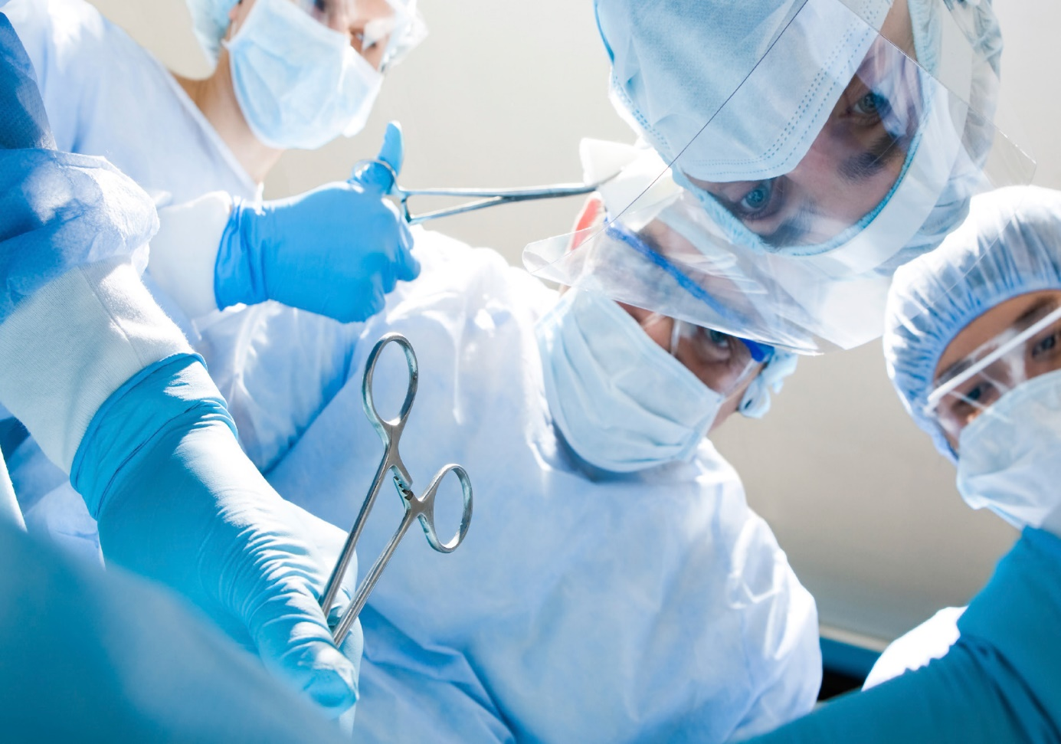
Sharps Safety in the OR
Let’s Walk the Talk
Overview
This sharps safety presentation provides the perioperative educator, manager, and staff RN with a complete presentation to educate perioperative team members on the importance of sharps safety in the surgical setting. This presentation emphasizes the techniques to prevent sharps injury in the surgical setting and can also be modified to meet the needs of the individual work setting.
Main Image Here
Objectives
Identify the risks of bloodborne pathogen exposure.
Discuss the current status of multidisciplinary OR sharps safety initiatives.
Discuss the components of an OR sharps safety program.
Describe barriers to change.

Slide 2
AORN Workplace Safety Background
Workplace Safety Task Force
Position Statement on Workplace Safety
Position Statement on Safe Work/On-call Practices
AORN Guidance Statement: Sharps Injury Prevention in the Perioperative Setting
AORN Recommended Practices for Sharps Safety
Safe Patient Handling & Movement
Surgical smoke initiatives
Workplace Safety Tool Kit
Notes:
AORN is committed to the creation and maintenance of a safe perioperative work environment to protect all of those present in the workplace and provide safe patient care. AORN supports research that is directed toward creating and maintaining safe work environments. Perioperative nurses are confronted with numerous occupational hazards that pose a risk of personal injury in the perioperative setting. Occupational hazards may have other negative impacts including:
An unsafe workplace contributes to work-related injuries and diseases that often result in physical, emotional, and financial difficulties for the perioperative nurse.
An unsafe workplace contributes to patient injuries.
Occupational injuries resulting from an unsafe workplace have a financial impact to the health care organization through increased costs and a reduced ability to provide services.
Occupational hazards in the workplace have been identified as one of the major contributors to nurses leaving the profession, contributing to the growing nursing shortage.
AORN further supports the Environmental Protection Agency, NIOSH, Occupational Safety and Health Association, and state and local regulations that promote workplace safety in the perioperative environment.

Slide 3
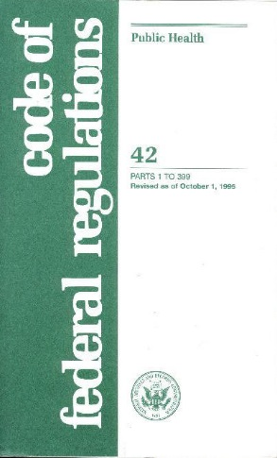
The Bloodborne Pathogens Standard
Promulgated by Occupational Safety and Health Administration (OSHA) in 1991
Purpose: to protect all workers who may come into contact with human blood or body fluids as a routine part of their job
Revised in 2001
New requirements for employers to maintain a sharps injury log and provide employees with safety needles
29 CFR 1910.1030. Occupational exposure. Bloodborne pathogens. 2009.Occupational safety and health standards: Bloodborne pathogens 191—10300. Occupational Safety and Health Administration. http://www.osha.gov/pls/oshaweb/owadisp.show_document?p_table=standards&p_id=10051. Accessed February 27, 2014.

Slide 4
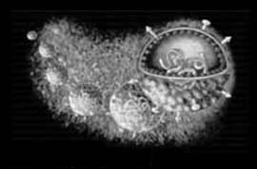
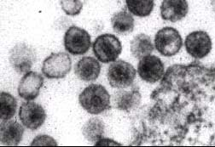
Epidemiology of Bloodborne Diseases
Bloodborne pathogens are viruses or infectious agents carried by human blood and body fluids
They can enter our bodies and cause disease and immune deficiencies, which can sometimes lead to death
Human Immunodeficiency Virus (HIV)
Hepatitis B Virus (HBV)
Hepatitis C Virus (HCV)

Slide 5
Transmission of Bloodborne Pathogens
Blood and body fluids
from accidents, illnesses, medical procedures, research samples, or handling medical waste
Disease transmission
through cuts, punctures, contact with broken skin, or contact with mucous membranes
Bloodborne Pathogen Prevalence*
Hepatitis B 1 in 20
Hepatitis C 1 in 50
HIV 1 in 250
* Prevalence in an average population, prevalence is higher for at risk populations

Slide 6
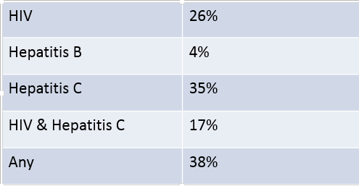
“Prevalence of Bloodborne Pathogens in an Urban, University-Based General Surgical Practice”*
Results: Prevalence of HIV, Hepatitis B and Hepatitis C
among Surgery Patients
* Weiss ES, Makary MA, Wang T, et al. Prevalence of blood-borne pathogens in an
urban, university-based general surgical practice. Ann Surg. 2005;241(5):803-809.

Slide 7
Prevalence of Bloodborne Pathogens *
Soft-tissue abscess procedures-71%
Lymph-node biopsies-67%
* Weiss ES, Makary MA, Wang T, et al. Prevalence of blood-borne pathogens in an urban, university-based general surgical practice. Ann Surg. 2005;241(5):803-809.

Slide 8
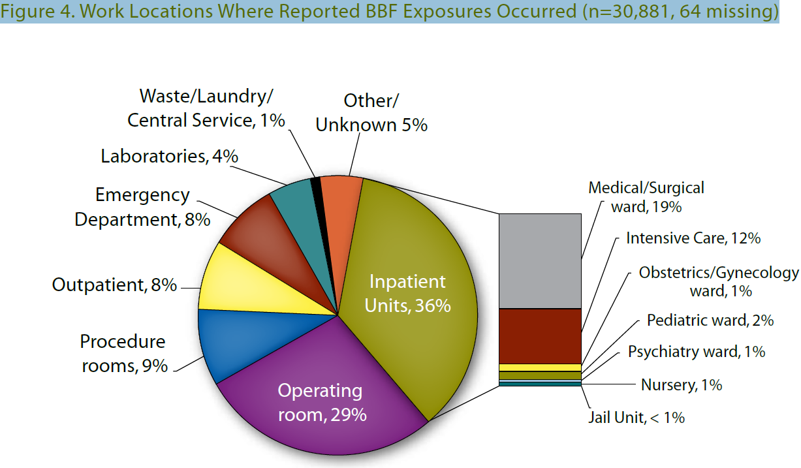
Locations: Blood and Body Fluid Exposures
http://www.cdc.gov/nhsn/PDFs/NaSH/NaSH-Report-6-2011.pdf

Slide 9
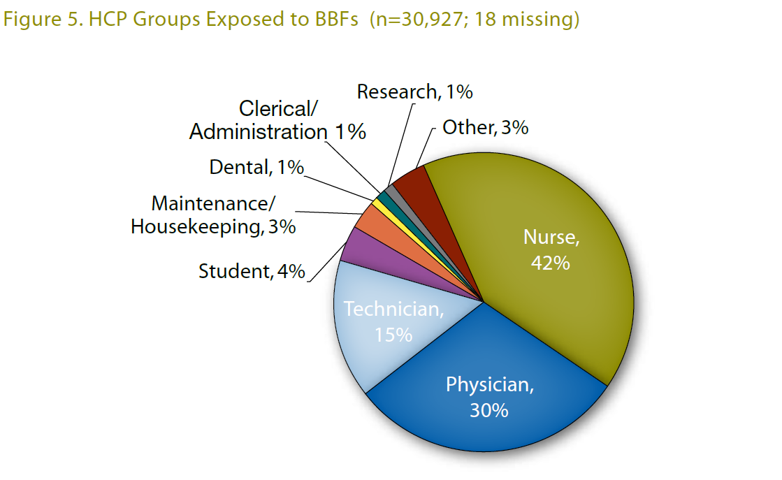
Personnel: Exposed to Blood and Body Fluids
http://www.cdc.gov/nhsn/PDFs/NaSH/NaSH-Report-6-2011.pdf

Slide 10
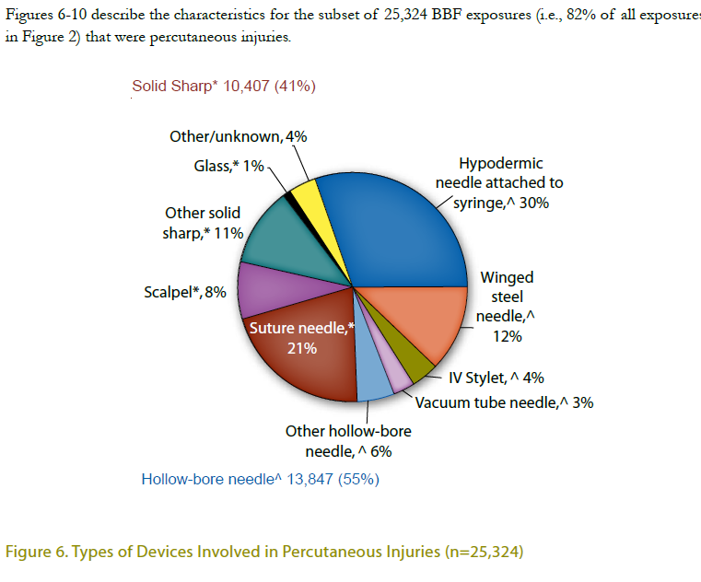
Sharps Injuries
http://www.cdc.gov/nhsn/PDFs/NaSH/NaSH-Report-6-2011.pdf

Slide 11
Increase in Sharps Injuries in Surgical Settings*
Update 1993-2006 Epinet Data
Outside the OR
In the OR
Injury rates increased 6.5%
Suture needles 43.4%
Scalpel blades 17%
Syringes 12%
75% of the injuries occurred during passing or use
Injury rates in non-surgical settings dropped 31.6%
*Jagger J, Berguer R, Phillips EK, Parker G, Gomaa AE. Increase in sharps injuries in surgical settings versus nonsurgical settings after passage of national needlestick legislation. J Am Coll Surg. 2010;210(4):496-502.

Slide 12
OR Sharps Injuries
Each year, 30% of the estimated needle sticks and other sharps-related injuries that occur happen in the OR.
Of injuries, 6% to 16% are self-inflicted while passing suture needles.
Sutures are the most frequent percutaneous injury.
Scalpels are the second most frequent percutaneous injury.

Slide 13
Patient Safety Risk
Percutaneous injury to perioperative personnel places patients at an equal risk.
The OR setting is the highest risk for this type of transmission.
Open wounds are susceptible to contamination.
Personnel injuries often result in bleeding.
Of 132 documented health care worker-to-patient transmissions of HIV, HBV, & HCV, 131 were transmitted during invasive surgery.
Reducing injuries during surgery would correspondingly reduce patients’ risk of exposure.
*Jagger J, Berguer R, Phillips EK, Parker G, Gomaa AE. Increase in sharps injuries in surgical settings versus Nonsurgical settings after passage of national needlestick legislation. J Am Coll Surg. 2010;210(4):496-502.

Slide 14
Organizational Support
Collaboration with National Institute for Occupational Safety and Health [NIOSH] – Memorandum of Understanding
Centers for Disease Control and Prevention (CDC) National Sharps Injury Prevention Meeting-2005
American College of Surgeons (ACS) Statement on the Sharps Safety
American Academy of Orthopedic Surgeons (AAOS)
Association of Surgical Technologists (AST)
Council on Surgical and Perioperative Safety (CSPS)
American Nurses Association (ANA) Recommitment: Safe Needles Save Lives- 2010
International Healthcare Worker Safety Meeting; University of Virginia-2010
Consensus Statement for Improving Sharps Safety-2012

Slide 15
Council on Surgical and Perioperative Safety (CSPS)
Principle #5 Sharps Safety
The CSPS endorses sharps safety measures to prevent injury during perioperative care.
Sharps safety measure should include
double-gloving;
use of blunt suture needles for fascia closure; and
use of the neutral zone, when appropriate, to avoid hand to hand passage of sharps.
Adapted 7.15.07, Modified 2.5.09

Slide 16
Hierarchy of Controls
Notes:
The hierarchy of controls is based on OSHA’s Bloodborne Pathogens Standard.

Slide 17
Hierarchy of Controls
Elimination of the hazard
Removing sharp objects from use when feasible
Engineering controls
Perioperative personnel must use sharps with safety-engineered devices
Blunt suture needles, safety scalpels, safety syringes, and needles
Notes:
Elimination of the hazard includes
removing the sharp object from use (eg, using electrocautery instead of a scalpel for the incision).
Engineering controls include
using a safety engineered device (eg, safety scalpel).

Slide 18
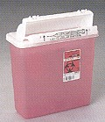
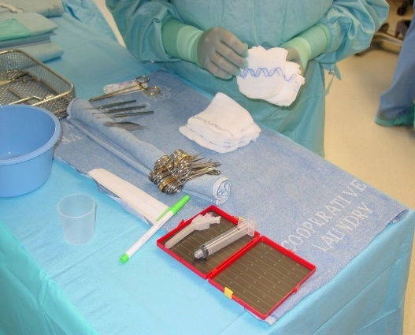
Hierarchy of Controls
Work practice controls
Perioperative personnel must use work practice controls when handling sharp devices
Neutral or safe zone
No touch technique
Sharp devices must be contained and disposed of safely
Notes:
Work place controls include using a neutral or safe zone for passing sharps instruments and devices and the sharps must be placed into a designated container and disposed of safely.

Slide 19
Hierarchy of Controls
Administrative controls
Health care facilities must establish a written exposure control plan.
Initial and ongoing education competency validation of their understanding of the principles and performance of the processes for sharps safety.
Documentation should reflect activities related to sharps safety.
Policies and procedures for sharps safety processes and practices should be developed.
Perioperative team members should participate in a variety of quality improvement activities.
Notes:
Administrative controls include developing policies and procedures, incorporating sharps safety prevention into a new or existing committee structure, implementing an exposure control plan, and education and training.

Slide 20
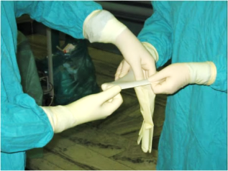
Hierarchy of Controls
Personal Protective Equipment (PPE)
Perioperative personnel must use PPE
Double gloving
Notes:
Wear proper PPE, including double gloving.

Slide 21
Creating an OR Sharps Safety Program
Engineering Controls
Tools, instruments, and sharps shelters
Blunt-tip suture needles, safety scalpels
Work Practices
Safe zone, and one-hand re-capping
PPE
Double gloving
Making Changes
Reviewing data, assembling committee, evaluating product, and active participation in education and safety conversion

Slide 22
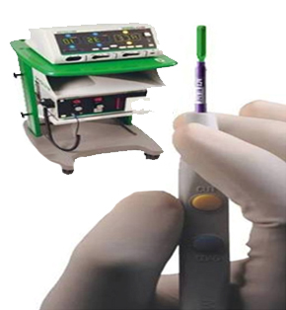
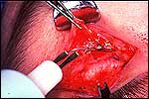
Implementation
Use alternative cutting methods:
Electrosurgery
Notes:
.

Slide 23
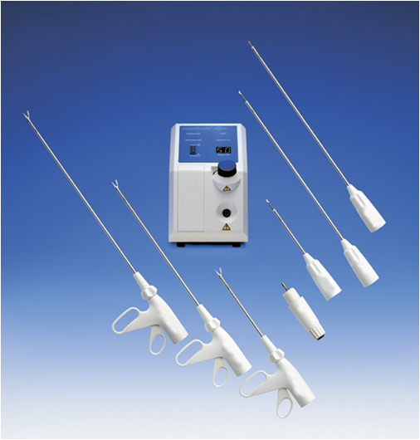
Implementation
Use alternative cutting methods
Ultrasonic scalpel

Slide 24
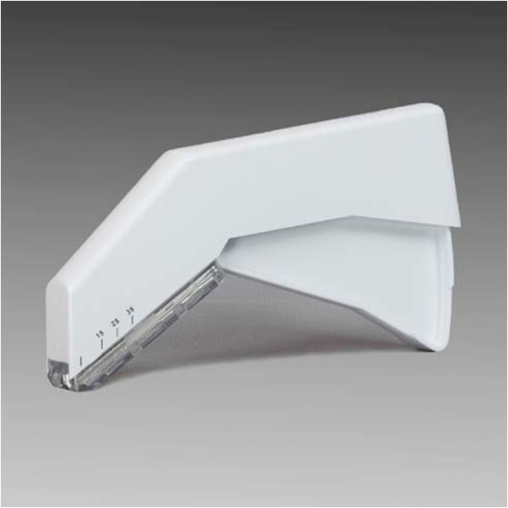
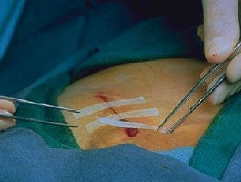
Implementation
Alternative suture devices
Blunt suture needles
Stapling devices
Adhesive strips
Glues
Blunt suture needle
Stapling device
Adhesive strips

Slide 25
Implementation
Use blunt rather than sharp retractors.

Slide 26
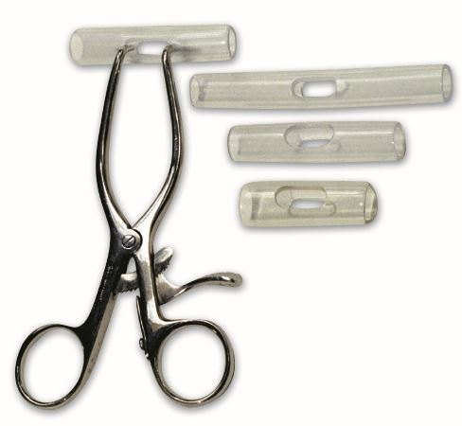
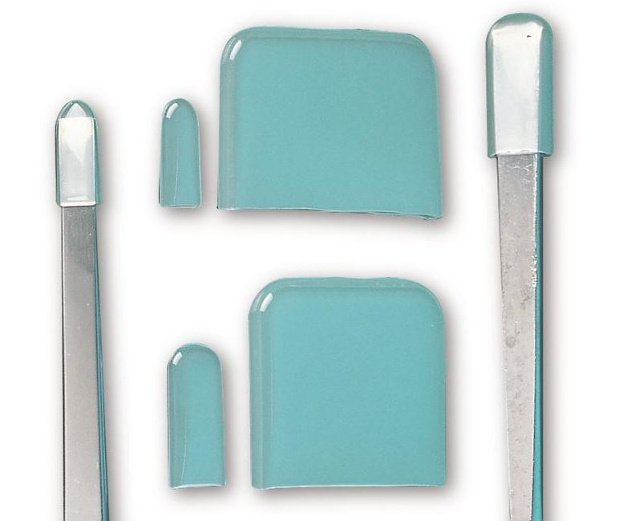
Implementation
Use protective caps on sharp instruments.
Courtesy of Aspen Surgical.
Notes:
The use of blunt suture needles is an engineering control.

Slide 27
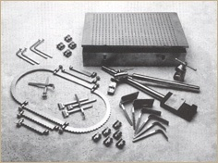
Implementation
Use mechanical/instrument tissue retraction whenever possible.

Slide 28
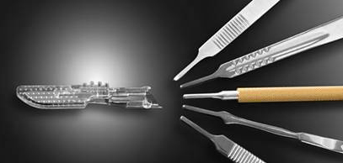
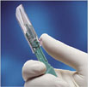
Implementation
Use scalpels with safety blades.
Reusable
Disposable
Notes:
The use of scalpels with safety blades is an engineering control

Slide 29
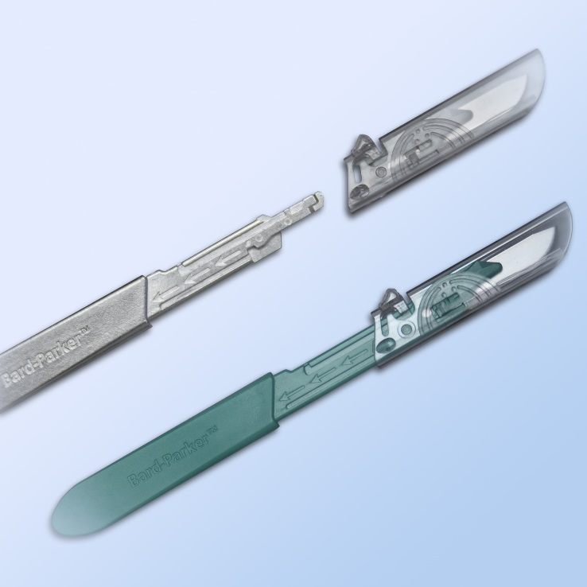
Implementation
Use next generation safety scalpel handles that will work with the any standard blade.
Courtesy of Aspen Surgical.

Slide 30
Implementation
Use blunt suture needles whenever possible.
Notes:
The use of blunt suture needles is an engineering control.

Slide 31
Joint Safety Communication
US Food and Drug Administration (FDA), the National Institute for Occupational Safety and Health (NIOSH), and OSHA.
Encourage health care professionals in surgical settings to use blunt-tip suture needles for suturing muscle and fascia when it is clinically appropriate.
Blunt-tip suture needles reduce the risk of needle stick injury the risk of bloodborne pathogen.
FDA, NIOSH and OSHA Joint Safety Communication: Blunt-Tip Surgical Suture Needles Reduce Needlestick Injuries and the Risk of Subsequent Bloodborne Pathogen Transmission to Surgical Personnel.
Notes:
FDA, NIOSH and OSHA Joint Safety Communication: Blunt-Tip Surgical Suture Needles Reduce Needlestick Injuries and the Risk of Subsequent Bloodborne Pathogen Transmission to Surgical Personnel. http://www.fda.gov/downloads/MedicalDevices/Safety/AlertsandNotices/UCM306035.pdf.

Slide 32
Support for Blunt Suture Needles
Suture needles are involved in as many as 77% of injuries.
The 2007 New England Journal of Medicine study states that 99% of surgical residents experience a stick during training; more than half were not reported.
An American College of Surgeon’s study states that surgeons and first assistants are at the highest risk, incurring as many as 59% of the injuries.

Slide 33
Support for Blunt Suture Needles
An Epinet Study found that 59% of suture needle injuries occurred during suturing of internal tissue and that the use of blunt suture needles could potentially reduce rates by as much as 30.4%.
Blunt needles are sharp enough to penetrate internal tissue with little or no change in technique but will not pierce the skin of the user.

Slide 34
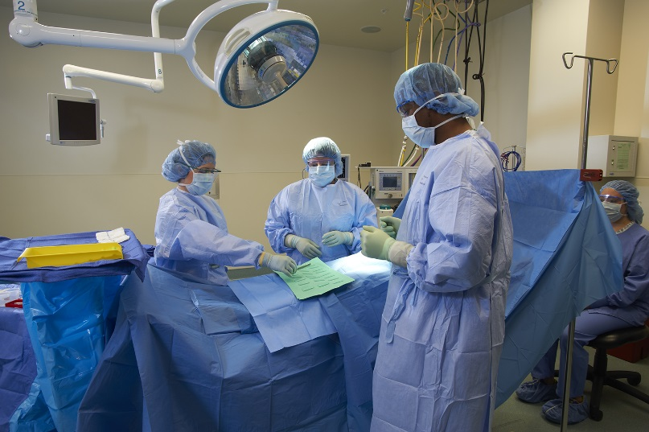
Implementation
Adopt the neutral zone/ hands-free technique of passing sharps and suture needles between perioperative team members
Notes:
The neutral zone/ hands-free technique is a work practice control

Slide 35
Neutral Zone
The neutral or safe zone is a designated area on the sterile field where a sharp can be placed and then picked up by the user.
The ideal device for a neutral zone should be large enough to hold sharps, not easily tipped over, and preferably mobile.
Kidney basins may be dangerous when used to pass instruments because fingers wind up inside the basin next to the sharp.

Slide 36
Neutral Zone
Only one sharp should be in the neutral zone at a time.
The person passing the sharp can announce “sharp” when moving the instrument.
There will be times when a surgeon cannot safely use the neutral zone because eye contact must be maintained with the surgical site.
Non-sharp instruments may still be passed hand-to- hand.
Courtesy of Aspen Surgical.

Slide 37
Why use a neutral zone?
One-fourth of suture needle injuries and more than one half of scalpel injuries occur when an instrument is passed from one person to another.

Slide 38
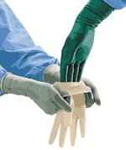
Implementation
Double gloving during all surgical procedures

Slide 39
Punctured Gloves Linked to Higher Infection Rates*
University Hospital; Basel, Switzerland
4,147 surgical procedures analyzed
Overall Surgical Site Infections(SSI) occurred 4.5% of time
Glove perforation
infections increased to 7.5% of time
compared to 3.9% of time when gloves remained intact
In procedures without prophylaxis but with perforation
12.7% compared to 2.9% when all gloves stayed intact
Misteli H, Weber WP, Reck S, et al. Surgical glove perforation and the risk of surgical site infection. Arch Surg. 2009;144(6):553-8.

Slide 40
Punctured Gloves Linked to Higher Infection Rates*
Recommendations
Use antibiotics in Class 1 procedures
Double gloving and changing gloves every two hours prevents glove puncture or breakage.
Studies cited in the article report that double gloving can reduce failure from a high of 51% to 7% depending on the study.
Double gloving also decreases surgical site infection.
* Misteli H, Weber WP, Reck S, et al. Surgical glove perforation and the risk of surgical site infection. Arch Surg. 2009;144(6):553-8.

Slide 41
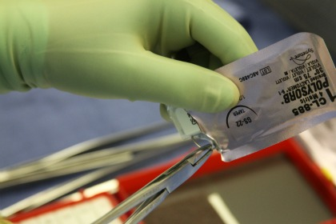
Implementation
No Touch Technique
Load suture needles using the suture pack to help mount the needle in the needle holder.
Use a one-handed or instrument-assisted suturing technique to avoid finger contact with needles.
Use “control-release” or “pop-off” needles.
Cut off the needle before tying knots.

Slide 42
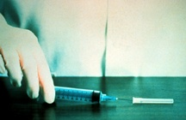
Implementation
DO NOT bend, break, or re-cap contaminated needles.
If re-capping is absolutely required, use a recapping device or the one-handed scoop technique:
One-handed scoop technique
Place the needle cap on the table.
Holding the syringe only, guide the needle into cap.
Lift up the syringe so cap is sitting on the needle hub.
Secure needle cap into place.
Notes:
Many procedures are either being done with local anesthetics or long acting anesthetics are being used for post op pain control.

Slide 43
Local Solution on the Back Table
High Volume - High Risk
Use multiple labeled syringes instead of refilling a single syringe that must then be re-capped.
The cost of using multiple syringes is only pennies compared to the cost of a needlestick both literally and emotionally.
Activate the device immediately after use.

Slide 44
Implementation
Keep used needles on the sterile field in a disposable puncture-resistant needle container.

Slide 45
Sharps Container Disposal
Sharps containers should either be color-coded red or orange and/or labeled with the universal biohazard symbol and the word “biohazard.”
Use closable, leakproof puncture resistant containers.
Place the sharps container close to the point-of-use and maintain it in an upright position either
wall mounted or
floor mounted.
Replace the container routinely and do not allow it to become overfull.

Slide 46
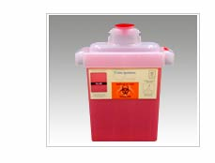
Sharps Disposal
Safety sharps containers
Goal: to prevent needlesticks
Counter-balanced drop
Automatically closes at ¾ full prevents overfilling
Reusable sharps containers
Goal: to reduce landfill waste
Outside contractor
removes contaminated sharps,
cleans container, and
returns it.

Slide 47
Improper Sharps Disposal
Knife blades and suture needles left on instruments that are returned to sterile processing have the potential to injure a sterile processing team member.
Sharps not accounted for at the end of the case may be discarded in the garbage or fall on the floor, and have the potential to injure an environmental services team member.

Slide 48
Worker Responsibilities
CDC Recommended work practices simplified:
be prepared,
be aware, and
dispose with care.
Observe regulations.
Actively participate in safety conversion.
Practice using safety devices.
Use safety devices.
Prevent hollow-bore injuries.

Slide 49
Worker Responsibilities
Comply with methods available to protect yourself.
Use personal protective equipment (i.e., surgical mask, eye protection, double gloving, fluid-resistant gown).
Use appropriate sharps containers.
Participate in education and follow recommendations.
Support others to follow the recommendations.
Follow your exposure control policy.
Report exposures.

Slide 50
Employer Responsibilities
Reporting Exposures
Employers are required by OSHA to document all staff member exposures to blood or body fluids anonymously.
OSHA 300 Log
Sharps Injury Log
Location, job title, description of incident, and type and brand of sharp involved
Source testing, risk analysis, and post-exposure prophylaxis

Slide 51
Employer Responsibilities
Comply with regulations.
Create a safety-oriented culture.
Encourage reporting.
Analyze data.
Provide training.
Evaluate devices.
Establish safe staffing patterns.

Slide 52
Barriers to Implementation
Psychosocial and organizational factors
Attitude and resistance to change
Shortcomings associated with safety devices
Perceived costs associated with engineered devices and safe work practices
Inadequate training
Time limitations

Slide 53
Barriers to Implementation
Communication
Resistance to change
Intimidation
Powerlessness
Inconsistencies
Perceived costs
Inaccurate beliefs

Slide 54
Communication
Practice change is effected by inadequate communication between OR administrators, managers, nursing staff members, and medical staff members.
Perceived lack of support from management may cause staff feel that they are not empowered to enforce policy and make change.
Lack of management follow through may lead to resistance to change.
Negative attitudes of staff members impede effective communication and teamwork.

Slide 55
Resistance to Change
Not wearing PPE.
Not using safety products.
Not using one handed recapping technique or multiple syringes as appropriate.
Not double gloving or failure to monitor for glove puncture
Not using a neutral or hands-free technique for passing sharps

Slide 56
Intimidation
Surgeon resistance to change may cause staff members to feel intimidated.
Surgeon is perceived as powerful and able to control policy and procedure implementation.
Team members do what it takes to get through the day and do not report noncompliant behavior.
Non-reporting leads to non-compliant behavior.
Lack of consistency in practice causes conflict between surgeons and staff members.

Slide 57
Powerlessness
Team members perceive surgeons as powerful and in control of policy and procedure implementation.
Staff members feel divisive and powerless.
Staff members feel negative to one another.
Staff members are unwilling to report surgeon’s behavior due to fear of reprisal.

Slide 58
Inaccurate Beliefs
Safety items are time consuming.
Safety items are cost prohibitive.
I am always careful.

Slide 59
Overcoming Obstacles to Compliance
Frequent and multiple training methods
Multidisciplinary sharps injury prevention plan
Education of new employees, incoming residents, and medical students
Multidisciplinary sharps safety committee
Networking with other facilities

Slide 60
Overcoming Obstacles to Compliance
Collaborate with personnel who use the device and facilitate change.
Discuss current research.
Work with resistant team members.
Remove old technology when new technology is trialed and available.
Create a culture of safety.

Slide 61
Developing & Implementing a Prevention Program
Organizational Steps
Assess
review what is currently in place
Document the development phase
Evaluate the impact of your prevention interventions
Workbook for Designing, Implementing, and Evaluating a Sharps Injury Prevention Program. Centers for Disease Control and Prevention. http://www.cdc.gov/sharpssafety/pdf/sharpsworkbook_2008.pdf. Accessed February 27, 2014.

Slide 62
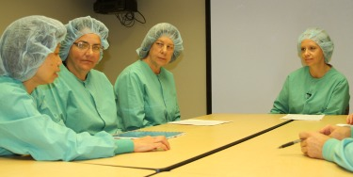
Assemble a Multidisciplinary Team
Develop an action plan
Review current process.
Operational processes
Assess culture of safety.
Identify a procedure for reporting injuries.
Analyze data and use of information.
Select, evaluate, and implement a program.
Educate and train personnel.

Slide 63
Education & Training Opportunities
Annual
BBP Training
Initial orientation to department
Annual bloodborne pathogens training
Staff development training on procedures
Introduction of new devices
Educate residents and medical students including using the products currently available for hands-on-training

Slide 64
Annual Training Content*
Number of sharps injuries reported
Occupations, devices, and procedures involved
The most common ways injuries occurred
Questions and Answers
opportunity for employees to ask questions.
*OSHA requirement

Slide 65
Sample Tool to Make Change
Assess Culture of Safety
Questions | Current Practice | Strategies for Improvement
What strategies does administration use to communicate the importance of safe environments for patients and health care personnel?
How has administration shown support for the introduction of safety interventions (eg, devices with engineered sharps injury prevention features)?
What strategies are used to document that sharps injury hazards have been corrected? How are workers who identify a hazard informed that corrective action has been taken?

Slide 66
Identify Procedure for Reporting Injuries
Questions | Current Practice | Strategies for Improvement
Where are copies of the organization’s policy/procedure for reporting occupational blood and body fluid exposures located? On what date was the policy/procedure last reviewed? Is this date within the past 12 months?
What items of information (eg, name, date, device, procedure) are collected on the injury report form? How does this list compare to the variables recommended standards?

Slide 67
Analyze Data & Use of Information
Questions | Current Practice | Strategies for Improvement
How are data on sharps injuries stored (eg, computerized database, incident log)? Where is the information kept?
Who compiles, analyzes, and interprets the data? How often is this done?
How often are summary reports on injury trends prepared? Who receives copies of this information?
What data sources (eg, committee reports) are used to monitor improvement in sharps injury data analysis?

Slide 68
Select, Evaluate, and Implement
Questions | Current Practice | Strategies for Improvement
What committee or group is responsible for evaluating devices with sharps injury prevention features? How are front-line workers involved in this review?
How are priorities determined for what devices will be considered for implementation? Which devices currently have the highest priority?
How are health care personnel trained in the use of new devices? Who is responsible for ensuring that this is done, and how is it documented?

Slide 69
Education and Training
Questions | Current Practice | Strategies for Improvement
How training is provided to the perioperative program?
Are there any groups who are not being reached?
How are students, per diem staff, members, and contractors trained on sharps injury prevention?
How is completion of training documented? Who is responsible for maintaining this information, and where is it located?

Slide 70
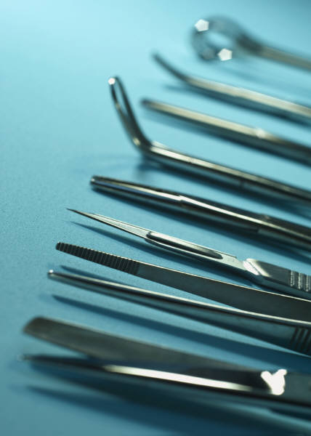
Sample Plan to Make Change Create a Case Study Presentation
What sharps injury occurred?
How did it happen?
Group discussion of prevention methods
Review facilities recommendations and suggestions for improvement

Slide 71
Change to Blunt Needles
Surgical champion(s)
Reasons to support change to blunt needles
surgeon safety
resident safety
education starts with them
surgical scrub safety
cost of suture verses cost of needlestick

Slide 72
Use Sales Representative
Set up the trial.
Plan the time line.
Work with positive surgeons.
Stage service lines.
Use the sales representative effectively by having him or her help surgical scrub person.
Select comparable suture for procedure.
Update preference cards with nursing staff.

Slide 73
Communication
Communicate with surgical chairpersons regarding the blunt suture trial with dates.
Recruit positive surgeons (champion) first.
Communicate with the perioperative staff members the trial and how it will work.
Substitute the blunt needle suture and remove the current product.
Provide evaluation sheets to be completed by surgeons.

Slide 74
Reasons to Change
Decreases potential for injury from inadvertent “sticks” while suturing.
Provides for addition of antibiotic coated suture.
Decreases incidents of glove punctures caused by needlesticks.

Slide 75
Cost Opportunities for Magnet Hospitals
Occupational health injuries
The CDC reports 385,000 needlestick injuries per year, which averages 67.5 per hospital.
Multiple studies report up to a 1/3 reduction in needlestick injuries in Magnet facilities at a cost of $405/event.
Blood and body fluid exposures are also lower in hospitals with Magnet status.
Drenkard K. The business case for Magnet. J Nurs Adm. 2010;40(6):263-271.
.

Slide 76
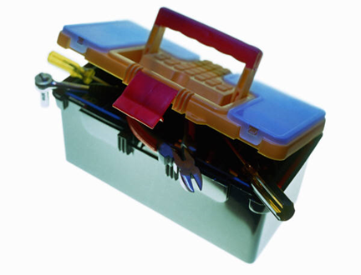
AORN Sharps Safety Tool Kit
Webinars
Slide decks
Evidence-based posters
Sample documents
Sample generic product evaluation tool
How to implement blunt-tip suture needles
Online resources
Literature review

Slide 77
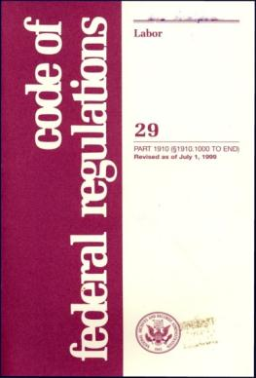
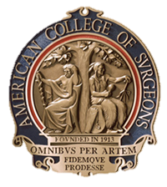
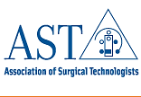
Sharps Safety
Law!
OSHA 29 CFR 1910.1030 (1992)
Needlestick Safety & Prevention Act (2000)
Evidence supports sharps safety measures
Support and recommendation of perioperative organizations
Notes:
Cochrane Reviews Systematic review of randomized controlled trials:
Blunt suture needles
Alternative wound closure
Double gloving

Slide 78
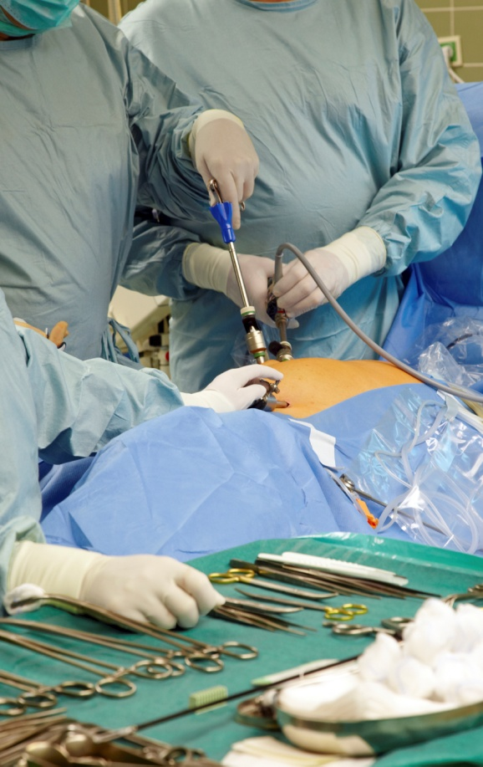
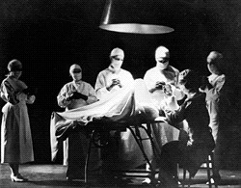
Yesterday Today

Slide 79
Clinical Nursing Practice Committee Sharps Safety Workgroup 2010-2012
Donna A. Ford, MSN,RN-BC,CNOR–Chairperson
Deborah G. Spratt, BSN,RN, MPA,CNOR,NEA-BC–Workgroup Lead
Beth A. Beilein, BSN,RN,MSM,CNOR
Nedra V. Brown, BSN,RN,MHA
Trudy A. Kenyon, RN,CNOR
Dawn M. Yost BSN,RN,CNOR
Ramon Berguer, MD
Sherri Alexander, CST
Jane Kusler-Jensen, RN,MBA,CNOR–Board liaison
Mary J. Ogg, MSN,RN,CNOR–Staff liaison

Slide 80
Sharps Safety in the OR
The End

