Slide 1
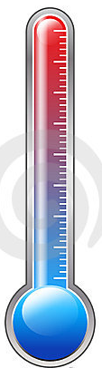
Perioperative Hypothermia
Victoria M. Steelman, PhD, RN, CNOR, FAAN
© 2019 The University of Iowa. All rights reserved.
Notes:
This educational program is about perioperative hypothermia and best practices for prevention.
Note: To best use these slides, insert comments from key leaders on the following slides:
3: surgeon leader/medical director
17: anesthesia champion
32: perioperative nurse executive
Have these individuals demonstrate support for prevention of perioperative hypothermia will improve the successful implementation of changes.

Slide 2
Introduction
Unplanned perioperative hypothermia is a common complication of surgery and can lead to serious, negative patient outcomes. This course will discuss normal thermal regulation, how perioperative hypothermia occurs, patient outcomes, and evidence-based interventions for prevention of perioperative hypothermia.
Notes:
Unplanned perioperative hypothermia is a common complication of surgery.
It can lead to serious, negative patient outcomes.
This educational program will discuss normal thermal regulation, the pathophysiology of perioperative hypothermia, adverse patient outcomes associated with hypothermia, and evidence-based interventions for prevention.

Slide 3
insert video clip of physician leader (chairperson of Surgical Services, safety officer, medical director) or
Option: Photo of facility and audio clip of physician leader .
Notes:
Physician/Surgeon leader:
I am (insert name of perioperative leader), (insert role).
Prevention of perioperative hypothermia is an important safety initiative here at _______________. By preventing hypothermia, we can decrease our patients’ risks of:
Surgical site infection
Morbid cardiac events
Blood loss and the need for blood transfusion
Prolonged recovery, and
The cost of patient care.
Thank you for attending this educational program. By all of us working together, we can continuously improve patient care.

Slide 4
Objectives
Upon completion of this program, you will be able to:
Describe the physiology of thermal regulation
Describe the pathophysiology of perioperative hypothermia
Identify adverse outcomes of perioperative hypothermia
Describe evidence-based practices for the prevention of perioperative hypothermia
Notes:
The objectives for this program are to:
Describe the physiology of thermal regulation
Describe the pathophysiology of perioperative hypothermia
Identify adverse outcomes of perioperative hypothermia
Describe evidence-based practices for the prevention of perioperative hypothermia

Slide 5
Thermoregulation
Normothermia is the body’s normal thermal state.
Core temperature is 37ºC (98.6ºF)
The peripheral tissues are 2-4ºC cooler
Perioperative hypothermia is usually considered <36ºC
The body regulates temperature in two ways:
Autonomic responses
Behavioral response
Notes:
The human thermoregulatory system usually maintains a core body temperature near 37°C, which is 98.6ºF. The peripheral tissues are usually about 2-4ºC cooler.
Although there is not complete consensus on the definition of hypothermia, it is generally accepted to be a temperature below 36ºC.
The body regulates temperature in two ways, through either autonomic responses or behavioral responses.

Slide 6
Body Temperature
Autonomic Responses
Thermoregulatory system maintains core temperature within a range 0.2ºC above or below 36ºC. When receptors perceive a change in core temperature beyond this threshold, they trigger the hypothalamus to initiate cooling or warming.
Thermoreceptors triggering autonomic responses are located in
Skin surface
Deep abdominal and thoracic tissue
Spinal cord
Hypothalamus
Other parts of the brain
Autonomic responses to cold are:
Vasoconstriction
Shivering
Notes:
The human thermoregulatory system maintains core temperature within a range 0.2ºC above or below 36ºC. This is called the interthreshold.
When receptors perceive a change in core temperature beyond this threshold, they trigger the hypothalamus to initiate cooling or warming.
Thermoreceptors triggering autonomic responses are located in the:
Skin surface
Deep abdominal and thoracic tissue
Spinal cord
Hypothalamus
Other parts of the brain
Autonomic responses to cold are vasoconstriction and shivering

Slide 7
Body Temperature
Behavioral Responses
Are triggered by thermal discomfort and are perceived change in skin temperature.
The individual responds by:
Adding clothing or blankets
Adjusting room temperature
Moving to a warmer location (e.g. indoors)
Notes:
Behavioral responses are triggered by a perceived change in skin temperature, not core temperature. The individual responses by:
Adding clothing or blankets
Adjusting room temperature
Moving to a warmer location (e.g. indoors)

Slide 8
How does Hypothermia Happen?
Anesthesia
General
Removes ability to employ behavioral responses
Widens the interthreshold range 10-fold
Diminishes the hypothalmic response
Regional
Response is similar to general anesthesia
Prevents normal activation of regional responses (sweating, shivering)
Impairs central control of thermoregulation
Incorrectly judges skin temperature
Patients often feel warm when they are not
Interthreshold range is increased by 0.6ºC
Notes:
So, how does periopeprative hypothermia occur?
The combination of anesthesia and cool environment result in hypothermia unless it is prevented.
First, general anesthesia removes the ability to employ behavioral responses to cold.
Secondly, general anesthesia widens the interthreshold range, the change in temperature that triggers a response, by 20 fold. So, instead of initiating a response when the core temperature decreases by 0.2ºC, the response isn’t triggered until the temperature drops 4ºC.
And, third, the hypothalmic response is diminished.
Perioperative hypothermia is also common when the patient receives spinal or epidural anesthesia.
Regional anesthesia impairs both peripheral and central thermoregulation.
It impairs normal activation of regional responses, such as sweating or shivering.
It impairs the central control of thermoregulation and causes the body to incorrectly judge skin temperature. So, patients often feel warmer than they are.
Regional anesthesia also increases the interthreshold range for triggering a response to a change in temperature, the response to cold does not occur at the normal drop in temperature. A drop of 0.6ºC is needed to trigger a thermoregulatory response.
So, anesthesia plays the major role in perioperative hypothermia. Understanding this is essential to effective prevention.
Sessler DI. Perioperative thermoregulation and heat balance. Lancet 2016;387:2655-64.

Slide 9
How does Hypothermia Happen?
Heat Loss
Heat is lost into the cool operating room environment
Large areas of skin often exposed during prepping and draping
Internal organs often exposed during surgery
Cool intravenous or irrigation fluids increase heat loss
Most patients undergoing surgery experience hypothermia unless effective prevention is used.
A recent study found that 72% of orthopedic surgery patients were hypothermic.
Notes:
Although general and regional anesthesia impair the patient’s response to a change in temperature, the cool environment results in heat loss as heat is transferred from the patient to the cool environment.
Factors contributing to heat loss include the skin exposure during prepping and draping, exposure of internal organs to the cool environment, and administration of cool fluids, either intravenously or irrigation of the wound.
The result of thermoregulatory impairment caused by anesthesia and this heat loss result in hypothermia unless it is effectively prevented.
A recent study found that 72% of orthopedic surgery patients were hypothermic. So, the problem is not just patients undergoing abdominal surgery.
Kleimeyer JP, Harris AHS, Sanford J, et al. Incidence and Risk Factors for Postoperative Hypothermia After Orthopaedic Surgery. J Am Acad Orthop Surg 2018.

Slide 10
Perioperative Hypothermia
Perioperative hypothermia is usually considered a core temperature <36ºC.
Unplanned perioperative hypothermia occurs in three phases:
Redistribution hypothermia
Upon induction of anesthesia
Slow, linear decline in temperature
~1-3 hours after induction
Temperature plateau
~3 -6 hours after induction
Notes:
Perioperative hypothermia is usually defined as a core temperature <36ºC.
So, how does perioperative hypothermia occur?
It occurs in three phases. The first phase occurs upon induction of anesthesia. During this phase, heat shifts from the core to the cooler peripheral tissues upon induction of anesthesia. The peripheral tissues are about 4ºC cooler than the core. So, this shift of heat is very significant.
From one to three hours after induction of anesthesia, the decrease in temperature slows, but the core temperature continues to go down. This occurs because the heat loss is more than heat production.
The third phase is a temperature plateau and occurs from about 3 to 6 hours after induction of anesthesia. Arteriovenous-shunt tone is reestablished and the core temperature of patients who become hypothermic during the first two phases reaches a plateau. During this phase there is little change in the core temperature.

Slide 11
Perioperative Hypothermia
Adverse Outcomes
Surgical site infection
Morbid cardiac events
Increased blood loss
Increased duration of action of anesthetic & neuromuscular blocking agents
Extended postanesthesia recovery
Increased cost of care
The next pages will go over each of these outcomes in detail.
Notes:
Perioperative hypothermia increases the risk of serious adverse outcomes, including:
Surgical site infection
Morbid cardiac events
Increased blood loss
Increased duration of action of anesthetic & neuromuscular blocking agents
Extended postanesthesia recovery
Increased cost of care
We are going to discuss these in more detail next.

Slide 12
Perioperative Hypothermia
Percent of Patients with Surgical site Infection
Adverse Outcomes - Surgical Site Infection
Vasoconstriction
Decreased oxygen in tissue
Decreased neutrophil activity
Decreased deposition of collagen
Decreased immune function
This figure shows the difference in surgical site
infection rates between subjects who were
Normothermic and those who were hypothermic.
Kurz A, Sessler DI, Lenhardt R. Perioperative normothermia to reduce the incidence of surgical-wound infection and shorten hospitalization. Study of Wound Infection and Temperature Group. N Engl J Med. 1996;334:1209-1215.
Notes:
Perioperative hypothermia increases the risk of surgical site infection. This occurs as a chain of events, starting with:
vasoconstriction and decreased tissue oxygenation. Neutrophil activity is decreased, which impairs the body’s ability to fight off infection.
Collagen deposition decreases, which impedes wound healing. And, the immune function is decreased.
The end result is an inability to effectively ward off infection, and triple the risk of surgical site infection.

Slide 13
Perioperative Hypothermia
Percent of Patients with Morbid Cardiac Events
Adverse Outcomes - Myocardial Events
Thermoregulatory responses effect cold stress on the cardiovascular system
Increases the risk of morbid cardiac event and ventricular tachycardia
This figure shows the difference in percent of morbid cardiac events between subjects who were normothermic and those who were hypothermic.
Frank SM, Fleisher LA, Breslow MJ, et al. Perioperative maintenance of normothermia reduces the incidence of morbid cardiac events. A randomized clinical trial. JAMA. 1997;277:1127-1134.
Notes:
But, increased risk of infection is not the only adverse outcome.
Perioperative hypothermia increases the risk of morbid cardiac events, including ventricular tachycardia. Thermoregulatory responses effect cold stress on the cardiovascular system. You can see from the figure on the right that this more than quadruples the risk of morbid cardiac events.

Slide 14
Perioperative Hypothermia
Adverse Outcomes - Blood Loss
Platelet function & coagulation cascade are impaired
Increased blood loss
This figure shows the results of two studies that found blood loss was greater when patients were hypothermic.
Average Blood Loss (mL)
1. Winkler M, Akca O, Birkenberg B, et al. Aggressive warming reduces blood loss during hip arthroplasty. Anesth Analg. 2000;91:978-984.
2. Schmied H, Kurz A, Sessler DI, Kozek S, Reiter A. Mild hypothermia increases blood loss and transfusion requirements during total hip arthroplasty. Lancet. 1996;347:289-292;
Notes:
Perioperative hypothermia also increases blood loss and the need for transfusion. Platelet function and the coagulation cascade are impaired. The figure on the right shows the results of two different studies of blood loss during hip arthroplasty.

Slide 15
Perioperative Hypothermia
Adverse Outcomes - Drug Metabolism
Hypothermia reduces drug metabolism
More than doubles the duration of action of neuromuscular blocking agents
Adverse Outcomes – Postanesthesia Recovery
This figure shows the increased duration of time in postanesthesia recovery
Length of Postanesthesia Stay (min)
Lenhardt R, Marker E, Goll V, et al. Mild intraoperative hypothermia prolongs postanesthetic recovery. Anesthesiology. 1997;87:1318-1323.
Notes:
Hypothermia also impairs drug metabolism. So, it takes the patient longer to metabolize anesthetic agents and neuromuscular blocking agents. This results in a longer period of time before the patient meets criteria for safe discharge from the postanesthesia care unit. You can see from the figure on the right, that this extension of time is significant.

Slide 16
Perioperative Hypothermia
Adverse Outcomes – Increase Cost of Care
Unplanned perioperative hypothermia increases the cost of care by $2500 to $7000 per patient.
Mahoney CB, Odom J. Maintaining intraoperative normothermia: A meta-analysis of outcomes with costs. AANA J. 1999;67:155-163.
Notes:
The combination of extended time in the postanesthesia care unit and treatment of adverse events increases the cost of patient care. In 1999, this cost was calculated to be between $2500 and $7000 per patient. It may be higher, now.

Slide 17
Insert video clip of anesthesia champion
Option: photo of hospital & audio clip of anesthesia champion
Notes:
Anesthesia Champion:
These reports aren’t just about patients in research studies. Patients here at __________________ have also become hypothermic.
Describe a case report from local facility

Slide 18
Ineffective Prevention
Increasing the room temperature in the OR
Passive warming
Cotton or reflective blankets
Heated cotton blankets
Circulating water mattress
Heating intra-abdominal CO2 during laparoscopy
Notes:
Some interventions have been found to be ineffective at preventing perioperative hypothermia. To understand why this is, we need to remember that anesthesia impairs heat production and causes redistribution hypothermia as the heat shifts from the warm core to the cooler peripheral tissues. So, interventions that could retain heat in the non-anesthetized patient are not going to be effective in the anesthetized patient.
First, is increasing the ambient temperature of the operating room. We cannot increase the environmental temperature enough to heat the patient’s peripheral tissues and prevent redistribution hypothermia.
Secondly, is passive warming with blankets. This is ineffective because the body is not generating enough heat.
Third, is a circulating water mattress. This intervention has been studied numerous times and found to be ineffective at preventing hypothermia, likely because of the limited skin surface contact. These mattresses also increase the risk of pressure injuries.
Last, a 2011 meta-analysis by Birch and colleagues studied the potential benefits of heating intra-abdominal gases. Sixteen studies were included in the analysis. There was no effect found on core temperature or other variables, with heated compared to cold gas insufflation, with or without humidification. This is an ineffective method of preventing perioperative hypothermia.

Slide 19
Effective Prevention
Active warming is required to prevent perioperative hypothermia. Peripheral tissues are heated, decreasing the temperature gradient between the core and periphery.
Types of Active Warming:
Forced-air warming
Radiant warming
Circulating water garment
Energy transfer pads
Carbon fiber resistive technology
Notes:
Active warming is required to prevent perioperative hypothermia. Peripheral tissues are heated, decreasing the temperature gradient between the core and periphery.
There are five types of active warming available:
Forced-air warming
Radiant warming
A circulating water garment
Energy transfer pads, and
Resistive electric modalities

Slide 20
Prevention
Forced Air Warming
The most commonly used form of active warming is forced air warming (FAW). Heat is transferred by convection and radiation.
Numerous clinical trials have demonstrated that intraoperative FAW is an effective intervention for preventing perioperative hypothermia. Intraoperative FAW is more effective in maintaining body temperature than:
cotton blankets
reflective blankets
thermo-lite® insulation
Notes:
The most commonly used form of active warming is forced air warming. Heat is transferred by convection and radiation by warm air blowing over a large skin surface area.
Numerous clinical trials have demonstrated that intraoperative forced air warming is an effective intervention for preventing perioperative hypothermia. These studies have found that intraoperative forced air warming is more effective in maintaining core body temperature than:
cotton blankets
reflective blankets, or
thermo-lite® insulation

Slide 21
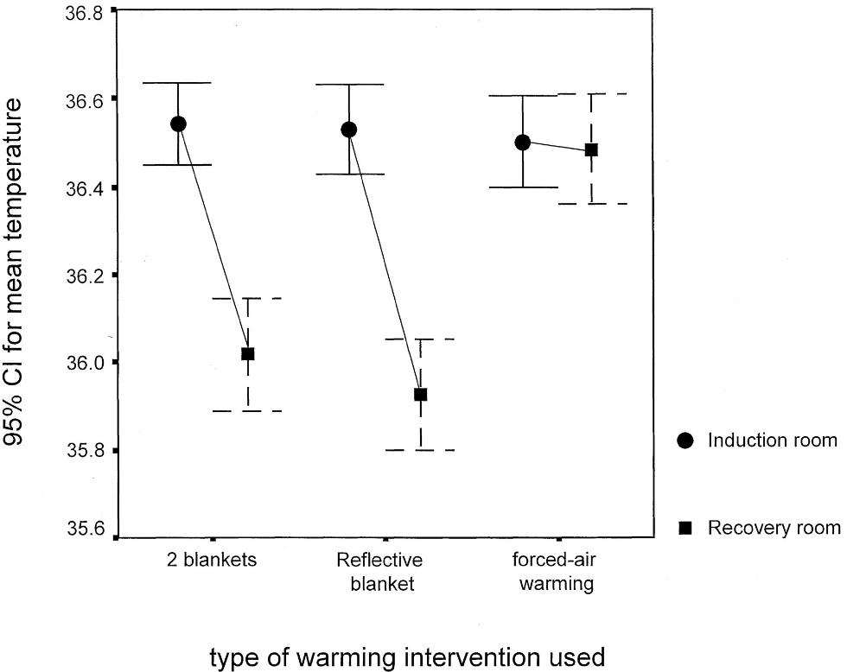
Prevention
Temperature Change in Patients Receiving Cotton Blankets, Reflective Blankets, or Forced Air Warming
Forced Air Warming
The figure to the right shows the mean temperature of patients from induction room to the postanesthesia care unit for three groups:
two-cotton-blankets group
reflective-blanket group
forced-air-warming group
Forced air warming was more effective in preventing hypothermia than passive warming with either cotton or reflective blankets.
Ng SF, Oo CS, Loh KH, Lim PY, Chan YH, Ong BC. A comparative study of three warming interventions to determine the most effective in maintaining perioperative normothermia. Anesth Analg. 2003;96:171-176.
Notes:
The effectiveness of forced air warming has been demonstrated by many randomized clinical trials.
The figure to the right shows the results of just one of these studies. It depicts the mean temperature of patients from induction room to the postanesthesia care unit for three groups:
Those receiving two-cotton-blankets
Those receiving a reflective-blanket, and
Those receiving forced-air-warming
Forced air warming was more effective in preventing hypothermia than passive warming with either cotton or reflective blankets.

Slide 22
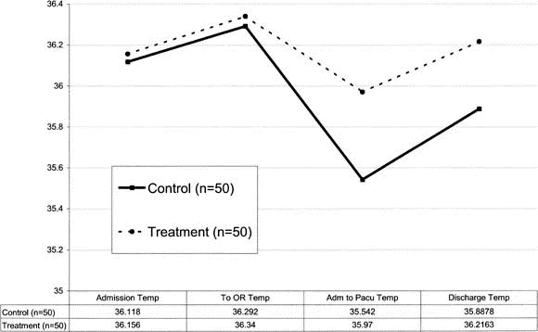
Prevention
Temperature Change in Patients Receiving Forced Air Warming versus Warmed Cotton Blankets
This figure shows the temperature trends between:
the treatment group (forced air warming, and
the control group (warmed cotton blankets)
Forced air warming was more effective in preventing hypothermia than warmed cotton blankets.
Fossum S, Hays J, Henson MM. A comparison study on the effects of prewarming patients in the outpatient surgery setting. J Perianesth Nurs. 2001;16:187-194.
Notes:
The effectiveness of forced air warming has also been compared with warmed cotton blankets. The treatment group received forced air warming and the control group received heated cotton blankets. You can see from the figure on the right, that forced air warming is much more effective than warmed cotton blankets. These warmed blankets do not prevent hypothermia.

Slide 23
Prevention
Preoperative Forced Air Warming
Research has found that to be most effective, forced air warming should be applied for at least 30 minutes preoperatively
Decreases the gradient in temperature between the core and periphery
Minimizes redistribution hypothermia
Notes:
Research has also examined the timing of application of forced air warming.
To be most effective, forced air warming should be applied for at least 30 minutes preoperatively. We need to heat the patient’s peripheral tissues enough that the gradient between the core and peripheral tissues is small.
So, when heat is shifted from the core to the peripheral tissues upon induction of anesthesia, the temperature drop is very small, preventing redistribution hypothermia. Let’s look at the research about this, because this is very important to understand.

Slide 24
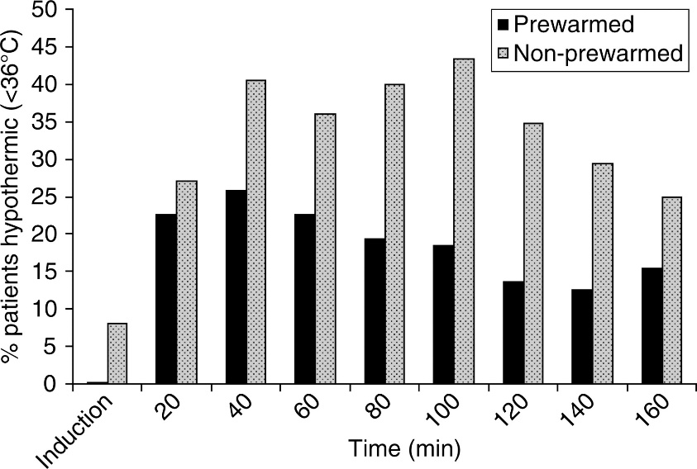
Prevention
Researchers have evaluated the effectiveness of using preoperative warming in addition to intraoperative warming.
The figure at the right compares the percentage of patients who were hypothermic at each interval of post-induction. Both groups received intraoperative warming.
Percentage of Patients Prewarmed and Not Prewarmed Who Became Hypothermic at Intervals .
Andrzejowski J, Hoyle J, Eapen G, Turnbull D. Effect of prewarming on post-induction core temperature and the incidence of inadvertent perioperative hypothermia in patients undergoing general anaesthesia. Br J Anaesth. 2008;101:627-631.
Notes:
Researchers have evaluated the effectiveness of using preoperative warming in addition to intraoperative warming.
The figure at the right shows the results of one study. One group received prewarming. One group did not. Both groups received intraoperative warming. The percentage of patients who became hypothermic at each interval of post-induction are depicted. You can see that the percent of patients who became hypothermic was much less in the group that received prewarming in addition to intraoperative warming.

Slide 25
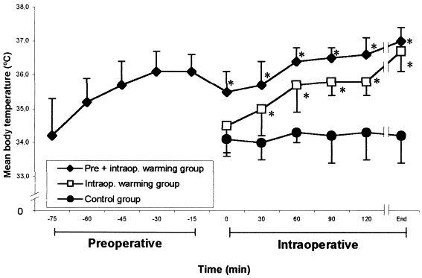
Prevention
Other researchers have also evaluated the effectiveness of using preoperative warming in addition to intraoperative warming.
The figure at the right shows the temperature changes in patients receiving prewarming and only intraoperative warming.
To be most effective, forced air warming should be applied for 30 minutes preoperatively, in addition to intraoperatively.
Temperature Changes in Patients Prewarmed and Not Prewarmed
Vanni SM, Braz JR, Modolo NS, Amorim RB, Rodrigues GR,Jr. Preoperative combined with intraoperative skin-surface warming avoids hypothermia caused by general anesthesia and surgery. J Clin Anesth. 2003;15:119-125
Notes:
Other researchers have also evaluated the effectiveness of using preoperative warming in addition to intraoperative warming.
The figure at the right shows the temperature changes in patients receiving prewarming and only intraoperative warming.
To be most effective, forced air warming should be applied for 30 minutes preoperatively, in addition to intraoperatively.

Slide 26
Other Forms of Active Warming
There are four other types of active warming:
Radiant warming
Circulating Water Garment
Energy transfer pads
Carbon fiber resistive warming
Notes:
Forced air warming is the most commonly used active warming technology. However, there are four other types of active warming:
Radiant warming
Circulating Water Garment
Energy transfer pads, and
Carbon fiber resistive warming

Slide 27
Prevention
Radiant Warming
A radiant warmer is available for active warming of the face during surgery.
Clinical trials have compared the effectiveness of this technology to forced air warming.
No prewarming was used. The results were inconsistent.
This technology is not commonly used in the United States.
Circulating Water Garment
A circulating water garment is available for use.
This technology was found to be effective in preventing perioperative hypothermia in long off-pump cardiac cases.
This technology is not commonly used in the United States.
Notes:
Radiant Warming
A radiant warmer is available for active warming of the face during surgery.
Clinical trials have compared the effectiveness of this technology to forced air warming.
No prewarming was used. The results were inconsistent.
This technology is not commonly used in the United States.
Circulating Water Garment
A circulating water garment is available.
This technology was found to be effective in preventing perioperative hypothermia in long off-pump cardiac cases.
This technology is also not commonly used in the United States.

Slide 28
Prevention
Energy Transfer Pads
Energy transfer pads are available for use. Only one study has been evaluated the effectiveness of this technology, and the sample size was too small for conclusions.
Carbon Fiber Resistive Warming
Carbon fiber technology is available for active warming. This technology has been found to be as effective as forced air warming for prevention of hypothermia.
Notes:
Energy transfer pads are available for use. Only one study has been evaluated the effectiveness of this technology, and the sample size was too small for conclusions.
Carbon fiber technology is available for active warming. This technology has been found to be as effective as forced air warming for prevention of hypothermia.

Slide 29
Active Warming and Neuraxial Anesthesia
Meta-analysis of 16 studies
1189 patients receiving spinal or epideural anesthesia
Active warming
lower incidence of hypothermia
Shaw CA, Steelman VM, DeBerg J, Schweizer ML. Effectiveness of active and passive warming for the prevention of inadvertent hypothermia in patients receiving neuraxial anesthesia: A systematic review and meta-analysis of randomized controlled trials. J Clin Anesth 2017;38:93-104.
Notes:
When patients receive neuraxial anesthesia (spinal or epidural), they are unable to judge temperature and often report that they are warm enough even when hypothermic. A recent meta-analysis of 16 studies found that for patients undergoing neuraxial anesthesia, the risk of hypothermia is less.
Shaw CA, Steelman VM, DeBerg J, Schweizer ML. Effectiveness of active and passive warming for the prevention of inadvertent hypothermia in patients receiving neuraxial anesthesia: A systematic review and meta-analysis of randomized controlled trials. J Clin Anesth 2017;38:93-104.

Slide 30
Active Warming
Meta-analysis of 13 studies
789 patients undergoing C-Section
Active warming:
Reduced temperature drop
Resulted in higher end of surgery temperatures
Associated with less shivering
Improved thermal comfort
Decreased incidence of hypothermia
Sultan P, Habib AS, Cho Y, Carvalho B. The Effect of patient warming during Caesarean delivery on maternal and neonatal outcomes: a meta-analysis. Br J Anaesth 2015;115:500-10.
Notes:
A meta-analysis of patients undergoing C-Section found that active warming reduced the temperature drop, resulted in higher end of surgery temperatures, resulted in less shivering, improved thermal comfort and decreased the incidence of hypothermia.
Sultan P, Habib AS, Cho Y, Carvalho B. The Effect of patient warming during Caesarean delivery on maternal and neonatal outcomes: a meta-analysis. Br J Anaesth 2015;115:500-10.

Slide 31
Prevention
Adjunct Therapy
Active warming is required to prevent perioperative hypothermia.
Adjunct measures should also be used to minimize heat loss
IV fluid warming
Warming of irrigation solutions
Notes:
Active warming is required to prevent perioperative hypothermia.
However, adjunct measures should also be used to minimize heat loss. These include warming of intravenous fluids and irrigation solutions.

Slide 32
Prevention
Adjunct Therapy - IV Fluid Warming
1 liter of room temperature solution decreases core temperature .25ºC
Prewarming IV fluids mitigates heat loss.
Surgical patients receiving warmed IV fluids were 0.4 - 0.9ºC warmer
A warming cabinet and in-line fluid warmer are both effective
Notes:
Administering 1 liter of room temperature IV solution decreases the core temperature .25ºC. Prewarming IV fluids mitigates heat loss.
Surgical patients receiving warmed IV fluids were found to be 0.4 - 0.9ºC warmer than those receiving cool fluids. Researchers have compared warming IV fluids in a warming cabinet compared to an in-line fluid warmer. Both methods of warming IV fluids are effective. So, warming of IV fluids should be used when more than one liter of fluid is administered. This is adjunct therapy to prevent heat loss, and alone will not prevent perioperative hypothermia.

Slide 33
Prevention
Adjunct Therapy - Warming of irrigation solutions
Irrigation fluids used in body cavities should be warmed. However, this intervention alone is inadequate to prevent perioperative hypothermia. It should be used as an adjunct to active warming preoperatively and intraoperatively.
Notes:
Irrigation fluids used in body cavities should be warmed. However, this intervention alone is inadequate to prevent perioperative hypothermia. It should be used as an adjunct to active warming preoperatively and intraoperatively.

Slide 34
Warming Irrigation Fluids for Arthroscopy
Meta-analysis of 6 studies
Results: When irrigation fluids are warmed for shoulder and hip arthroscopy:
Risk of hypothermia is less
Drop in intraoperative temperature is less
Lowest body temperature is higher
Risk of postoperative shivering is less
Steelman VM, Chae S, Duff J, Anderson MJ, Zaidi A. Warming of Irrigation Fluids for Prevention of Perioperative Hypothermia During Arthroscopy: A Systematic Review and Meta-analysis. Arthroscopy 2018;34(3):930-42 e2.
Notes:
A meta-analysis combining the results of 6 research studies found that warming irrigation fluids for shoulder and hip arthroscopy reduced the risk of hypothermia, minimized the drop in core temperature, the lowest body temperature was higher, and that shivering was less. The reason for this is that the fluid extravasates into the surrounding tissue, which is close to the core. We know from this that warming of irrigation fluids for shoulder and hip arthroscopy ures is important. However, this cannot be generalized to knee arthroscopy.
Steelman VM, Chae S, Duff J, Anderson MJ, Zaidi A. Warming of Irrigation Fluids for Prevention of Perioperative Hypothermia During Arthroscopy: A Systematic Review and Meta-analysis. Arthroscopy 2018;34(3):930-42 e2.

Slide 35
Inert video clip of the nurse executive with responsibility for the operating room and preoperative areas.
Option: Insert a photo of the facility and an audio clip of nurse executive.
Notes:
Nurse Executive:
Because of the importance of preventing perioperative hypothermia, we will be making changes in our practice, including:
(list changes here, eg.
initiating forced air warming before anesthesia start
implementing preoperative warming for 30 minutes in the preop area and holding area
Implementing pre-warming of IV fluids used in the preop area and operating room)
On behalf of our steering committee, we thank you in advance for your support of this important project. We will be measuring adherence and rates of hypothermia and giving you progress reports.

Slide 36
Summary
Anesthesia impairs thermoregulation
Most patients will experience hypothermia unless effectively prevented
Perioperative hypothermia is associated with negative outcomes
Prevention of hypothermia requires active warming (e.g. forced air warming)
To be more effective forced air warming should be initiated preoperatively
Heat loss should be minimized by adjunct therapy
Warming of IV fluids
Warming of irrigation fluids
Changes here in our operating rooms and preoperative areas
Notes:
Anesthesia impairs thermoregulation.
Most patients undergoing surgery under general or regional anesthesia will experience hypothermia unless effective interventions are used.
Perioperative hypothermia is associated with serious, negative outcomes.
Research has shown that prevention of hypothermia requires active warming. The most commonly used active warming is forced air warming.
To be more effective, forced air warming should be initiated for 30 minutes preoperatively
In addition to this evidence-based intervention, heat loss should be minimized by adjunct therapy, including warming of IV fluids when more than one liter is administered and warming of irrigation fluids used in body cavities.
We have also highlighted leadership support for preventing perioperative hypothermia and changes that we are making here in our operating room and preoperative areas.

