Slide 1
Perioperative Care of the Adult Transgender Patient
Part 3 – Health Care Needs

Slide 2
Health Care Needs
Gender-affirming care is medically necessary
WPATH
Endocrine Society
Starts with cultural competence
Gender dysphoria
High rates of depression, anxiety, drug and alcohol abuse, HIV, diabetes, heart disease, self-harm, and homelessness
“Trans Broken Arm Syndrome”
Medical treatments may include
Hormone therapy
Gender-affirming surgeries
Notes:
“Transgender healthcare is neither experimental nor cosmetic: it is grounded in evidence-based practice” (Neira & Bowman, 2022, p.408).
WPATH (World Professional Association for Transgender Health) provides standards of care that are international guidelines for the provision of transgender care (Neira & Bowman, 2022).
The Endocrine Society provides guidelines for hormone therapy (Neira & Bowman, 2022).
Gender-affirming care is recognized as medically necessary by major reputable professional health organizations in the United States (Neira & Bowman, 2022).
Addressing the health care needs of the transgender population starts with cultural competence. Traditionally, health care has been approached with a gendered mindset, applying issues to either men or women. This isn’t applicable when caring for this population, particularly with non-binary individuals. One approach would be to address each individual based on their personalized needs and health status. It has even been suggested to keep an organ inventory for patients—what they were born with and what they have currently. This could be beneficial for all patients (Neira & Bowman, 2022). Cultural competence is the integration and transformation of knowledge about individuals and groups of people into specific standards, policies, practices, and attitudes to increase the quality of health outcomes. The more we know about a group, the more we can apply to our practice and make a real difference.
In 2010, the American Psychiatric Association (APA) removed the term gender identity disorder from the Diagnostic and Statistical Manual of Mental Health Disorders (DSM-5) and replaced it with the term gender dysphoria, defined as an intense discomfort a trans person may feel about physical attributes or the way they’re gendered by others; this can be social, physical, or emotional, can be overwhelming; and can interfere with day-to-day life. The APA changed its terminology to emphasize that transgender people are not disordered but feel distress when their physical appearance does not match their gender identity.
There are high rates of depression, anxiety, drug and alcohol abuse, HIV, diabetes, heart disease, self-harm, and homelessness in this population.
Trans broken arm syndrome is a term for when a patient is seeking care for something unrelated to gender identity, but the condition is dismissed or ascribed to the patient’s trans status or hormone treatment (Neira & Bowman, 2022).
Gender-affirming medical treatments may include hormone therapy and gender-affirming surgeries.

Slide 3
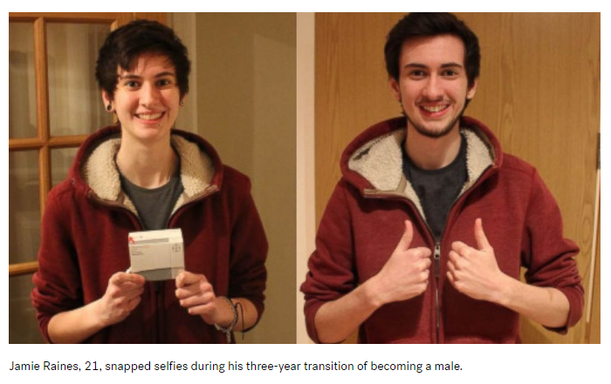
Transition
Highly variable
Gradual
Social
Interactions
Mannerisms
Speech
Physical
Clothes
Makeup
Hair
Medical interventions
https://abcnews.go.com/Lifestyle/man-21-snaps-selfies-year-gender-transition-captivating/story?id=34345608
Notes:
Transitioning is when someone takes steps to socially or physically feel more aligned with their gender identity. It’s not about what appeals to other people or trying to appear cisgender. It’s about doing what feels right for them. This is different for each person. This can be gradual, and it is flexible. People may change their mind about what works best for them.
Social transitioning involves the way trans people interact with other people. This can be through mannerisms, gait, or speech.
Physical transitioning usually involves a person altering their appearance to what feels right for them, through clothing, makeup, or hairstyle, or seeking medical treatment like hormones or gender-affirming surgery.

Slide 4
Hormone Therapy
Alters biological sex characteristics
Induces physical changes caused by puberty (secondary sex characteristics)
Matches gender identity and body (gender congruence)
Can
Make gender dysphoria less severe
Reduce psychological and emotional distress
Improve psychological and social functioning
Notes:
Hormone therapy alters biological sex characteristics. It will induce physical changes typically caused by puberty—the secondary sex characteristics.
The idea is that it will promote matching gender identity and body (gender congruence). It can make gender dysphoria less severe, reduce psychological and emotional distress, and improve psychological and social functioning (Collister, Saad, Christie, & Ahmed, 2012).
Due to barriers in receiving appropriate health care, some trans individuals may work around health care to acquire hormones and are not appropriately monitored.

Slide 5
Feminizing Hormone Therapy
If started before male puberty, male secondary sex characteristics, such as increased body hair and changes in voice pitch, can be avoided.
Antiandrogens block testosterone and suppress testosterone production.
Estrogen decreases testosterone production and induces feminine secondary sex characteristics:
Skin softening
Breast development
Decrease in body hair
Changes in body composition
Increased body fat and decreased lean body mass
Progesterone
Breast development
Used alone or in combination with feminizing surgery
58% rate of unsupervised hormone used in the feminine presenting population
Notes:
(Collister, Saad, Christie, & Ahmed, 2012)
(Tollinche et al., 2018)

Slide 6
Feminizing Hormone Therapy Risks
Thromboembolic disease
Prolactinoma (benign tumor of the adrenal gland that produces prolactin)
Liver disease
Breast cancer
Hypertriglyceridemia
Cardiac and vascular disease
Migraines
Stroke
Infertility
Adverse effects can include depression, increased risk of suicidal thoughts, mood swings, hyperprolactinemia, elevated liver enzymes, and decreased insulin sensitivity.
Notes:
(Collister, Saad, Christie, & Ahmed, 2012)
(Harned & Harper, 2021)

Slide 7
Labs
Goal is to maintain estradiol concentrations within the physiological range for cisgender women (100–200 pg/mL)
Platelets
Increase
Risk for thrombolytic event
Potassium
Spironolactone increases K retention
Prolactin
Increased with estrogen
Increased risk of developing pituitary adenomas
Creatinine – slight decrease
ALT
Lipids
Glucose
Notes:
(Allen et al., 2023)

Slide 8
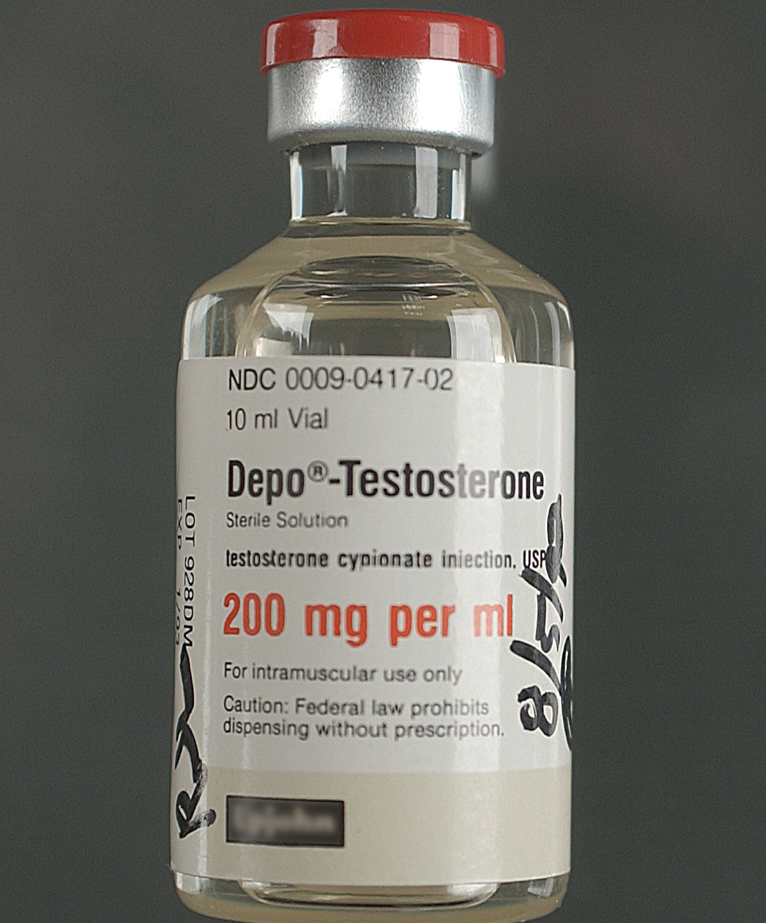
Masculinizing Hormone Therapy
If started before the changes of female puberty begin, female characteristics, such as breast development, can be avoided.
Testosterone induces physical changes caused by male hormones during puberty (secondary sex characteristics):
Suppresses menstrual cycles
Decreases production of estrogen from ovaries
Used alone or in combination with masculinizing surgery
Voice deepening
Body and facial hair growth
Body fat redistribution
Increased muscle mass and strength
Clitoral enlargement and vaginal atrophy
Notes:
(Collister, Saad, Christie, & Ahmed, 2012)
(Tollinche et al., 2018)

Slide 9
Masculinizing Hormone Therapy Risks
Polycythemia
Dyslipidemia
Hypertension
Sleep apnea
Type 2 diabetes
Endometrial cancer
Liver disease
Infertility
Deep vein thrombosis and/or pulmonary embolism
Increased risk for intraoperative or postoperative bleeding
Increased risk of hematoma formation
Adverse effects can include depression, increased risk of suicidal thoughts, mood swings, hyperprolactinemia, elevated liver enzymes, migraines, and decreased insulin sensitivity, weight gain, and male pattern baldness.
Notes:
(Collister, Saad, Christie, & Ahmed, 2012)
(Wu et al., 2021)

Slide 10
Labs
Goal is to maintain testosterone concentration within the physiological range for cisgender men (400–700 ng/dL)
Hemoglobin
Hematocrit
RBC
Platelets
Creatinine
ALT
Lipids
Glucose
Notes:
(Allen et al., 2023)

Slide 11
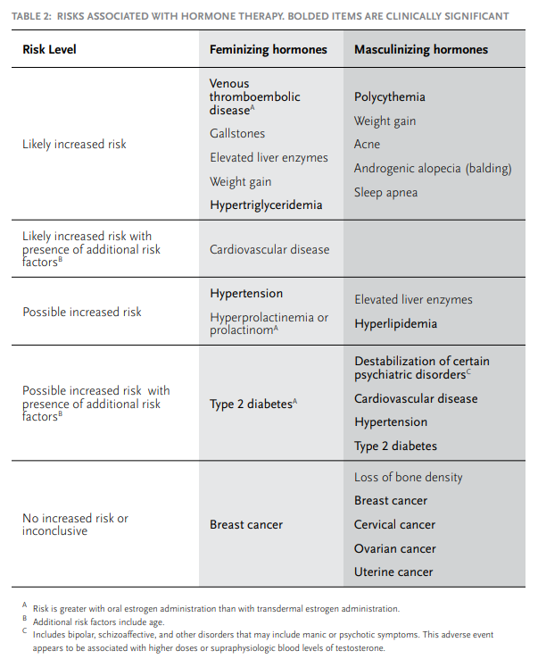
Hormone Therapy Risks Chart
Notes:
https://www.wpath.org/media/cms/Documents/SOC%20v7/SOC%20V7_English.pdf
Standards of Care for the Health of Transsexual, Transgender, and Gender Nonconforming People.
The World Professional Association for Transgender Health.

Slide 12
Perioperative Considerations for Patients Undergoing Hormone Therapy
Consider prolonged operating time in lithotomy position
Estrogen has been associated with venous thromboembolism through many mechanisms
Consider prophylactic subcutaneous heparin, early ambulation, and sequential compression devices
Considerable variation in practice patterns related to hormone management leading up to surgery include:
Holding hormones 2-6 weeks before surgery
Continuing hormones throughout the perioperative period
Considering reversal of some acquired secondary sex characteristics
Potentially distressing
Individualize treatment
Notes:
(Wu et al., 2022)
(Tollinche et al., 2018)

Slide 13
Gender-Affirming Surgeries
Gender affirming surgeries can include many options, and combinations, but are not always a necessary component of gender-affirming care.
Feminizing - orchiectomy, penectomy, vaginoplasty, labiaplasty, clitoroplasty, breast augmentation, vocal feminization
Masculinizing - mastectomy, hysterectomy, salpingo-oophorectomy, vaginectomy, metoidioplasty, phalloplasty, scrotoplasty, urethroplasty
Other cosmetic options - blepharoplasty, face lift, hair removal, lipoplasty, thyroid chondroplasty, rhinoplasty
Nonbinary considerations
Notes:
Surgeries are not a necessary component of trans identity. You can be trans and never have a gender-affirming surgery. We shouldn’t assume a trans person wants or intends to have surgery. It is a sensitive, private topic of discussion. Be respectful and do not bring this up in discussion unless it’s initiated by the individual (Neira & Bowman, 2022).
Orchiectomy - a component of “lower” or “bottom” surgery for transgender women. It can be performed prior to vaginoplasty as a separate procedure or in conjunction with vaginoplasty.
Penectomy – another component of “bottom” surgery. The penis is disassembled in a way that can be used to create a vagina.
Vaginoplasty – creation of a vagina. The most common technique is the penile inversion technique, which presents the considerations of limited depth vs additional grafting, increased risk, and increased surgical time. Additional grafting will be needed for a full vaginal canal. It can be taken from the scrotum; however, a new peritoneal flap option performed via robotic abdominal surgery has become popular. There is also an intestinal option, but this is becoming less popular due to over production of mucus, harvest complications, and chronic malodor.
Labiaplasty – creation of the vulva and labia with excess scrotal tissue. There is a risk for dehiscence in this area. Jackson-Pratt drains can be placed to decrease fluid buildup and incision tension. There is an option for a feminizing second stage labiaplasty to additionally define the outer genitalia.
Clitoroplasty – creation of a natural looking and sometimes functional clitoris. The glans can be used to construct a clitoris with sensation.
Urethroplasty
Breast augmentation
Mastectomy – removal of the breasts.
Metoidioplasty – a simple one-staged option for a creating a phallus from a hormonally enlarged clitoris.
Phalloplasty – total phalloplasty is the creation of a neophallus with similar volume to a genetic male. It is a complex and multistaged procedure. The neophallus is created from exogenital tissue and must be large enough to accommodate a penile prosthesis, function sexually, and allow for voiding while standing up. The most common construction is with a radial free forearm flap. The musculocutaneous latissimus dorsi flap is an alternative option.
Salpingo-oophorectomy
Scrotoplasty – A scrotum is created by joining both labia majora and insertion of testicular implants
Urethroplasty – the urethra is lengthened. This can be done with genital skin flaps or oral mucosal grafts. This presents risks for urethral fistula and stricture.
Vaginectomy – vaginal mucosa is removed except the small part around the urethral opening, which can be used later for urethral lengthening. The space of the removed vaginal tissue is approximated and closed, giving the look of a male perineum.
Hair removal – critical for gender affirmation surgery. In phalloplasty, any hair-bearing skin used for the neourethra can lead to chronic infection and obstruction. In vaginoplasty, failure to perform preoperative or intraoperative hair removal can lead to inaccessible hair deep within the vagina. Therefore, pre-vaginoplasty removal of all penile shaft hair and scrotal hair is generally recommended when scrotal skin use is planned.
Blepharoplasty
Face Lift
Hair removal- electrolysis or laser hair removal.
Lipoplasty
Thyroid chondroplasty
Rhinoplasty
(Collister, Saad, Christie, & Ahmed, 2012)
(Djordjevic, Stojanovic, & Bizic, 2019)
(Pariser & Kim, 2019)
(Tollinche et al., 2018)

Slide 14
Gender-Affirming Surgeries
Complication Risks:
Bleeding
Infection
Dehiscence
Graft rejection
Fistulas
Need for additional surgeries
Obstructive uropathy
Notes:
There are risks for intraoperative rectal and urethral injury due to the nature of the surgery location. There will be a need for life-long dilation of the neovaginal canal. Vaginal stenosis can occur if the regimen is not followed and continued.
(Collister, Saad, Christie, & Ahmed, 2012)
(Djordjevic, Stojanovic, & Bizic, 2019)
(Pariser & Kim, 2019)
(Tollinche et al., 2018)

Slide 15
References for Part 3
Allen AN, Jiao R, Day P, Pagels P, Gimpel N, SoRelle JA. Dynamic impact of hormone therapy on laboratory values in transgender patients over time. J Appl Lab Med. 2021;6(1):27-40. https://doi.org/10.1093/jalm/jfaa192
Collister D, Saad N, Christie E, Ahmed S. Providing care for transgender persons with kidney disease: a narrative review. Can J Kidney Health Dis. 2021;8:2054358120985379. https://doi.org/10.1177/2054358120985379
Djordjevic ML, Stojanovic B, Bizic M. Metoidioplasty: techniques and outcomes. Transl Androl Urol. 2019;8(3):248-253. https://doi.org/10.21037/tau.2019.06.12
Harned LK, Harper RJ. Prolactinoma in a male to female transgender woman on gender affirming hormone therapy. J Endocr Soc. 2021;5(suppl 1):A795. https://doi.org/10.1210/jendso/bvab048.1617
Neira PM, Bowman RC. Improving perioperative nursing care for transgender and gender-diverse patients. AORN J. 2022;116(5):404-415. https://doi.org/10.1002/aorn.13808
Pariser JJ, Kim N. Transgender vaginoplasty: techniques and outcomes. Transl Androl Urol. 2019;8(3):241-247. https://doi.org/10.21037/tau.2019.06.03
Standards of Care for the Health of Transexual, Transgender, and Gender Nonconforming People. 7th version. The World Professional Association for Transgender Health. 2001. Accessed June 3, 2024. https://www.wpath.org/media/cms/Documents/SOC%20v7/SOC%20V7_English.pdf
Tollinche LE, Walters CB, Radix A, et al. The perioperative care of the transgender patient. Anesth Analg. 2018;127(2):359-366. https://doi.org/10.1213/ANE.0000000000003371
Wu SS, Raymer CA, Kaufman BR, Isakov R, Ferrando CA. The effect of preoperative gender-affirming hormone therapy use on perioperative adverse events in transmasculine individuals undergoing masculinizing chest surgery for gender affirmation. Aesthet Surg J. 2022;42(9):1009-1016. https://doi.org/10.1093/asj/sjac091

