Slide 1
Management of Surgical Smoke Tool Kit
Part I: Introduction to Surgical Smoke

Slide 2
Overview and Learning Outcome
Surgical smoke is hazardous and can negatively affect the health of surgical patients and perioperative team members. This learning activity presents perioperative nursing care and current best practice guidelines for managing and preventing exposure to surgical smoke for both patients and health care personnel during operative and other invasive procedures.
Perioperative RNs and other interested health care providers can use the knowledge gained from this activity to safely manage surgical smoke and prevent and decrease surgical patients’ and health care providers’ exposure to surgical smoke.

Slide 3
Objectives
The participant will be able to:
Identify the hazardous contents of surgical smoke.
State guidelines for surgical smoke evacuation and control.
Describe perioperative nursing care to minimize the hazards of surgical smoke for surgical patients.

Slide 4
Instructions
This tool kit contains five slide decks related to the management of surgical smoke in the perioperative setting:
Part I: Introduction to Surgical Smoke
Part II: Hazards of Surgical Smoke
Part III: An Overview of Health Care Regulations, Standards, and Guidelines Related to Surgical Smoke
Part IV: Smoke Evacuation in the Perioperative Setting
Part V: Additional Perioperative Nursing Care

Slide 5
Instructions
Each slide deck contains notes for the learner.
The slide decks are provided so you can teach all perioperative team members about the management of surgical smoke in the perioperative environment.
We recommend that you review all of the slide decks in the order listed.

Slide 6
Part I
Introduction to Surgical Smoke

Slide 7
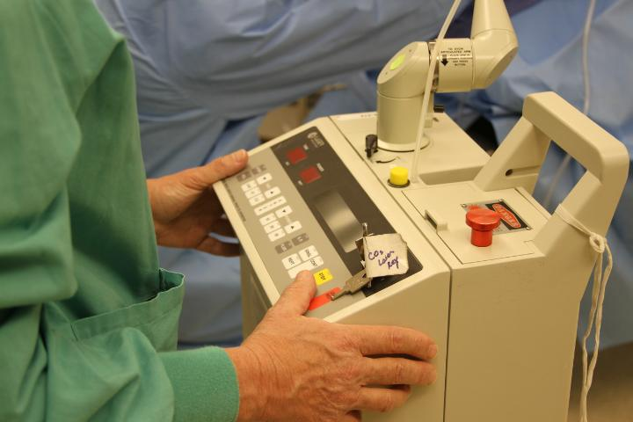
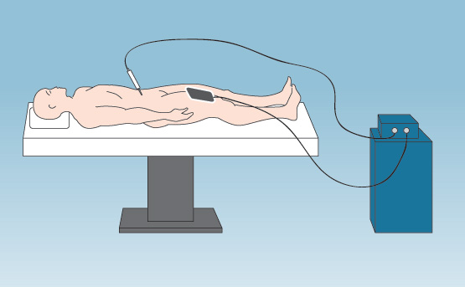
What is Surgical Smoke?
Surgical smoke (ie, smoke plume) is the vaporization of substances (eg, tissue, fluid, blood) into a gaseous form and is a by-product of surgical instruments used to destroy tissue.
Instruments
Lasers
Electrosurgical units (ESUs)
Notes:
What is Surgical Smoke? “Surgical smoke” or “surgical plume” can be described as the vaporization of substances (for example, tissue, fluid, and blood) into a gaseous form. It is a by-product of surgical devices that are used to destroy tissue. Surgical smoke can be generated by the use of lasers and electrosurgical units.

Slide 8
Content of Surgical Smoke
Gaseous toxic compounds
Bio-aerosols
Dead and live cellular material (including blood fragments)
Viruses
Carbonized tissue
Bacteria
Notes:
Surgical smoke can contain gaseous toxic compounds; bio-aerosols; and live and dead cellular material, including viruses and bacteria.

Slide 9
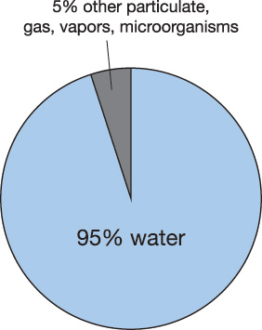
Composition of Surgical Smoke
150 different chemicals have been identified in surgical smoke
Notes:
Surgical smoke produced by the carbon dioxide (CO₂) laser is composed of 95% water and 5% particulates, gases, and microorganisms. Roughly 150 different chemicals including benzene, toluene, formaldehyde, and cyanide have been identified in surgical smoke.¹ The smoke content that is generated from the CO₂ laser is consistent with the smoke content generated by other energy-producing devices.
Reference
Pierce JS, Lacey SE, Lippert JF, Lopez R, Franke JE. Laser-generated air contaminants from medical laser applications: a state-of-the-science review of exposure characterization, health effects, and control. J Occup Environ Hyg. 2011;8(7):447-466.

Slide 10
Water Vapor
Smoke plume and aerosols contain 95% water vapor.
Water vapor itself is not harmful, but it acts as a carrier.
Notes:
We know water vapor is not in itself harmful, but it can act as a carrier for particulates of surgical smoke.

Slide 11
So… Is Surgical Smoke Harmful?
Misconceptions:
“Surgical smoke is not hazardous.”
“Surgical smoke is sterile.”
Surgical Smoke is Hazardous!
Notes:
In the past, there have been misconceptions about laser plume or smoke. It was not considered a health hazard because many thought that when tissue was vaporized with the laser, the smoke was sterile. This is not true! We now know that exposure to surgical smoke can be harmful to patients as well as perioperative team members.

Slide 12
Summary Part I
Surgical smoke (ie, smoke plume) is the vaporization of substances (eg, tissue, fluid, blood) into a gaseous form and is a by-product of surgical instruments used to destroy tissue.
Surgical smoke can be generated by laser and electrosurgical devices.
Surgical smoke is a hazard to patients and health care providers.

Slide 13
End of Part I
Please continue to the next slide deck: Part II
Part I: Introduction to Surgical Smoke
Part II: Hazards of Surgical Smoke
Part II: An Overview of Health Care Regulations, Standards, and Guidelines Related to Surgical Smoke
Part III: Smoke Evacuation in the Perioperative Setting
Part IV: Additional Perioperative Nursing Care

