Slide 1
Management of Surgical Smoke Tool Kit
Part IV: Surgical Smoke Evacuation

Slide 2
Instructions to the Learner
This tool kit contains five slide decks related to the management of surgical smoke in the perioperative setting. It is recommended to review the slide decks in order. This is Part IV.
Part I: Introduction to Surgical Smoke
Part II: Hazards of Surgical Smoke
Part III: An Overview of Health Care Regulations, Standards, and Guidelines Related to Surgical Smoke
Part IV: Smoke Evacuation in the Perioperative Setting
Part V: Additional Perioperative Nursing Care

Slide 3
Part IV
Smoke Evacuation
in the Perioperative Setting

Slide 4
Evacuate Surgical Smoke
Smoke evacuator systems
In-line filters
MIS smoke evacuation systems
Notes:
The AORN Guideline for Surgical Smoke Safety includes recommendations to evacuate surgical smoke.¹ It is important for the learner to review the entire guideline. Some recommendations within this guideline are:
II. The perioperative team should evacuate all surgical smoke.
II.a.2. A smoke evacuator with a 0.1 μm filter (eg, ultra-low particulate air [ULPA]) should be used when surgical smoke is anticipated.
II.b.1. The smoke evacuation system (eg, smoke evacuator, medical-surgical vacuum with in-line filter) should be activated at all times while surgical smoke is being generated.
Reference
Guideline for surgical smoke safety. In: Guidelines for Perioperative Practice. Denver, CO: AORN, Inc; 2018:469-498.

Slide 5
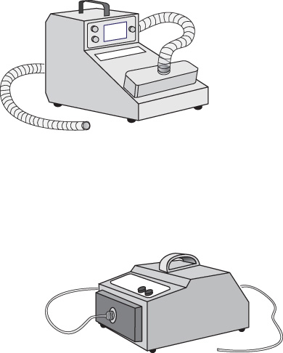
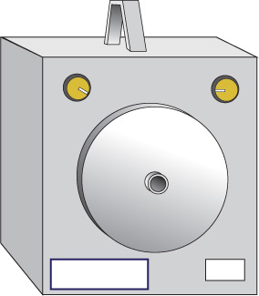
Evaluating Smoke Evacuators
Many products
Evaluate the features and benefits
Notes:
A number of manufacturers make smoke evacuators. Personnel who make decisions about equipment in the health care facility should carefully evaluate the features and benefits of the equipment and select the devices that best suit the needs of the practice area.

Slide 6
Evaluating Smoke Evacuation Systems
Type of filters (eg, ULPA, carbon)
Type of filter monitoring system
Does the system have
variable flow rates to accommodate different amounts of smoke?
automatic remote activation?
Noise level
Is the system compatible with existing products?
How effective and efficient is the system?
Cost
Notes:
Before purchasing smoke evacuation systems, an interdisciplinary team that includes perioperative RNs, surgeons, and scrub personnel should convene to evaluate and select surgical smoke safety equipment, including smoke evacuation systems. Other team members may include biomedical engineers, infection preventionists, and materials management personnel. As noted on this slide, there are many factors to consider.¹
Surgical specialists, for example, plastic surgeons or urologists, should collaborate with the team to also evaluate and consider the use of alternative energy-generating devices that produce lesser amounts of surgical smoke. Bipolar instruments and ultrasonic equipment are known to produce lesser amounts of surgical smoke.
Reference
Guideline for surgical smoke safety. In: Guidelines for Perioperative Practice. Denver, CO: AORN, Inc; 2018:87.

Slide 7
Critical Features of Smoke Evacuators
Efficiency
Filtering capability
Suction power
Notes:
The efficiency of the smoke evacuator unit is a critical feature to evaluate. This includes the unit’s filtering capability and the suction power of the unit.

Slide 8
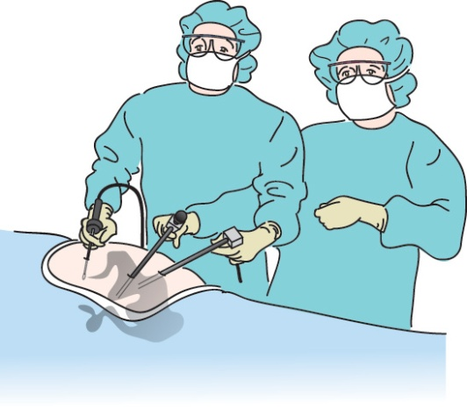
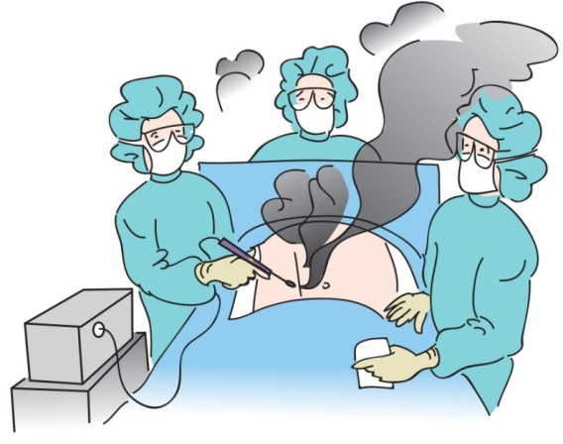
Smoke Capture
Motor rating
Tubing size
Site proximity
Amount of smoke generated
Notes:
The amount of smoke that is captured depends on the motor rating of the smoke evacuator, the tubing size of the collection device, the proximity of the collection tubing to the site where the smoke is being generated, and the amount of smoke being created.

Slide 9
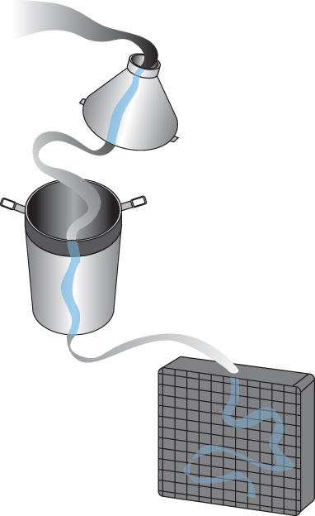
Triple Filter System
Pre-filter (captures large particles)
ULPA filter (captures small particles)
Charcoal filter (captures toxic gases and odors)
Notes:
A triple filter system in the smoke evacuator includes a pre-filter to capture large particles and fluid, an ULPA filter that captures small particulate matter, and a charcoal filter that absorbs toxic gases and odors.¹
Reference
Ball K. Lasers: The Perioperative Challenge. 3rd ed. Denver, CO: AORN, Inc; 2004.

Slide 10
Wall Suction: Use an In-Line Filter
Use an in-line filter:
Use and change as recommended by the manufacturer’s instructions
Use standard precautions when changing and disposing of in-line filters
Notes:
The OR wall suction with an in-line filter can evacuate very small amounts of smoke (eg, smoke that may be generated by using electrosurgery during a septoplasty procedure). An in-line filter serves to protect the wall suction line from getting clogged with surgical smoke particulate matter. The in-line filter should be used and changed as recommended by the manufacturer’s instructions for use. Standard precautions should be used when changing and disposing of contaminated in-line filters.

Slide 11
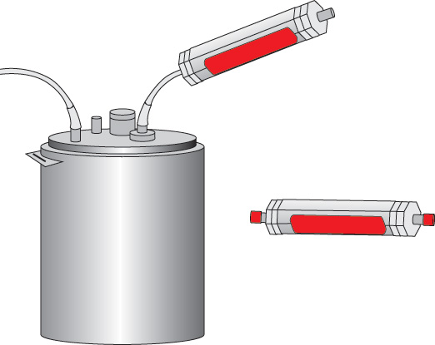
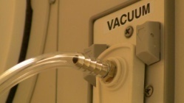
In-Line Filters with Wall Suction
To wall suction >
From the patient >
Example of a filter
Notes:
This is an example of suction tubing from the patient attached to a suction canister. The in-line filter is connected between the suction canister and the wall suction connection.

Slide 12
Wall Suction
When there is no in-line filter:
Damage to health care facility air exchange system
Notes:
Suction lines in the health care facility can be damaged with surgical smoke particles if an in-line filter is not used. The smoke particles can accumulate and harm the hospital air exchange system and may result in reduced airflow.

Slide 13
Evacuating Surgical Smoke During Minimally Invasive Procedures
Use an individual smoke evacuation unit
with a 0.1 micron filter
Evacuate and filter surgical smoke
during the procedure
at the end of the procedure when the pneumoperitoneum is released
.
Notes:
Surgical smoke should be evacuated and filtered during minimally invasive procedures and at the end of procedures when the pneumoperitoneum is released. When surgical smoke is generated, a smoke evacuation unit with a 0.1 micron filter should be used to remove surgical smoke.¹
Reference
Guideline for surgical smoke safety. In: Guidelines for Perioperative Practice. Denver, CO: AORN, Inc; 2018:469-498.

Slide 14
Disposing of and Changing Smoke Evacuation Filters
It’s an occupational hazard.
Wear personal protective equipment.
Dispose of used smoke evacuation filters per the manufacturer’s instructions and your facility’s procedures for disposing of biohazardous waste.
Notes:
When changing smoke evacuator filters, standard precautions should be used, and the manufacturer’s written instructions as well as your facility’s procedures for managing hazardous waste should be followed.

Slide 15
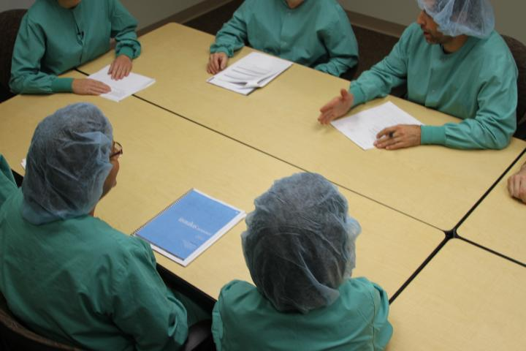
Smoke Evacuation Program
Increase awareness of the hazards of surgical smoke
Promote and implement safe practices
Interdisciplinary team
Include perioperative RNs, anesthesia professionals, surgeons, scrub persons, and personnel from administration, infection prevention, employee health, safety, and risk management
Notes:
A first step in developing a smoke evacuation program is to make a commitment to protect patients and the surgical team from the potentially harmful effects of surgical smoke. This commitment should be made with representatives from each of the professional groups providing care in the OR: surgeons, anesthesia professionals, perioperative RNs, and scrub personnel. Also include personnel from administration, infection prevention, employee health, safety, and risk management.

Slide 16
Promote Evidence–Based Practices
Administration:
Director
Infection Prevention
Safety
Risk Management
Surgeons and other Physicians
Business and Finance:
Contracts
Capital
Cost Analysis
Perioperative RNs, Scrub Personnel, Sterile Processing, Environmental Services
Notes:
It’s important to include the entire interdisciplinary team to develop a successful Smoke Evacuation Program. We have listed many of the team members, and you may think of others to include at your facility.

Slide 17
Implementing Smoke Evacuation Practices
Provide data and evidence to support best practices
Scientific research data
Financial analysis
AORN guidelines for perioperative practice
Work collaboratively
Administrative Safety Committee
Infection Prevention
Risk Management
Notes:
Educating perioperative team members about the hazards of surgical smoke is important. Take advantage of all available resources in designing education to increase awareness about smoke evacuation practices. Leadership support is also essential for implementing, maintaining, and enforcing a smoke evacuation program.

Slide 18
Barriers to Compliance for Smoke Evacuation Practices
Equipment not available Physician preference Equipment is noisy Complacent staff -- Ball, 2010 | Surgeons’ resistance or refusal Cost Bulkiness Excessive noise --Edwards & Reiman, 2012 | Noise Distraction Ergonomic difficulty of equipment --Watson, 2010
Notes:
Barriers to smoke evacuation practices should be identified and addressed. As you see on the slide, several authors have reported reasons for non-compliance of smoke evacuation practices.¹⁻³
References
Ball K. Compliance with surgical smoke evacuation guidelines: implications for practice. AORN J. 2010;92(2):142-149.
Edwards BE, Reiman RE. Comparison of current and past surgical smoke control practices. AORN J. 2012;95(3):337-350.
Watson DS. Surgical smoke evacuation during laparoscopic surgery. AORN J. 2010;92(3):347-350.

Slide 19
Summary
There are a variety of smoke evacuators available.
Select a smoke evacuator that meets the needs of the patient and the health care facility.
Wear PPE when handling and disposing of smoke evacuation filters.
Convening an interdisciplinary team is recommended to help develop and maintain a successful Smoke Evacuation Program at your health care facility.

Slide 20
End of Part IV
Please continue to the next slide deck: Part V
Part I: Introduction to Surgical Smoke
Part II: Hazards of Surgical Smoke
Part III: An Overview of Health Care Regulations, Standards, and Guidelines Related to Surgical Smoke
Part IV: Smoke Evacuation in the Perioperative Setting
Part V: Additional Perioperative Nursing Care

